Slide 1
Nevada’s Employment Outlook and UI Trust Fund Forecast
Presentation to Employment Security Council
October 6, 2025

Slide 2

Taking a moment…
In prior years, we’ve presented the “state solvency measure.” The COVID recession exposed significant weaknesses in this formula, and it was no longer providing valuable guidance. AB 21 of the 2025 legislative session eliminated this formula, so moving forward we’re relying on the Average High Cost Multiple (as we have
presented in the past) instead.

Slide 3

Presentation Overview
Economic Conditions and Context
Unemployment Insurance Trends
UI Trust Fund Projections and Solvency
Where are we going?

Slide 4
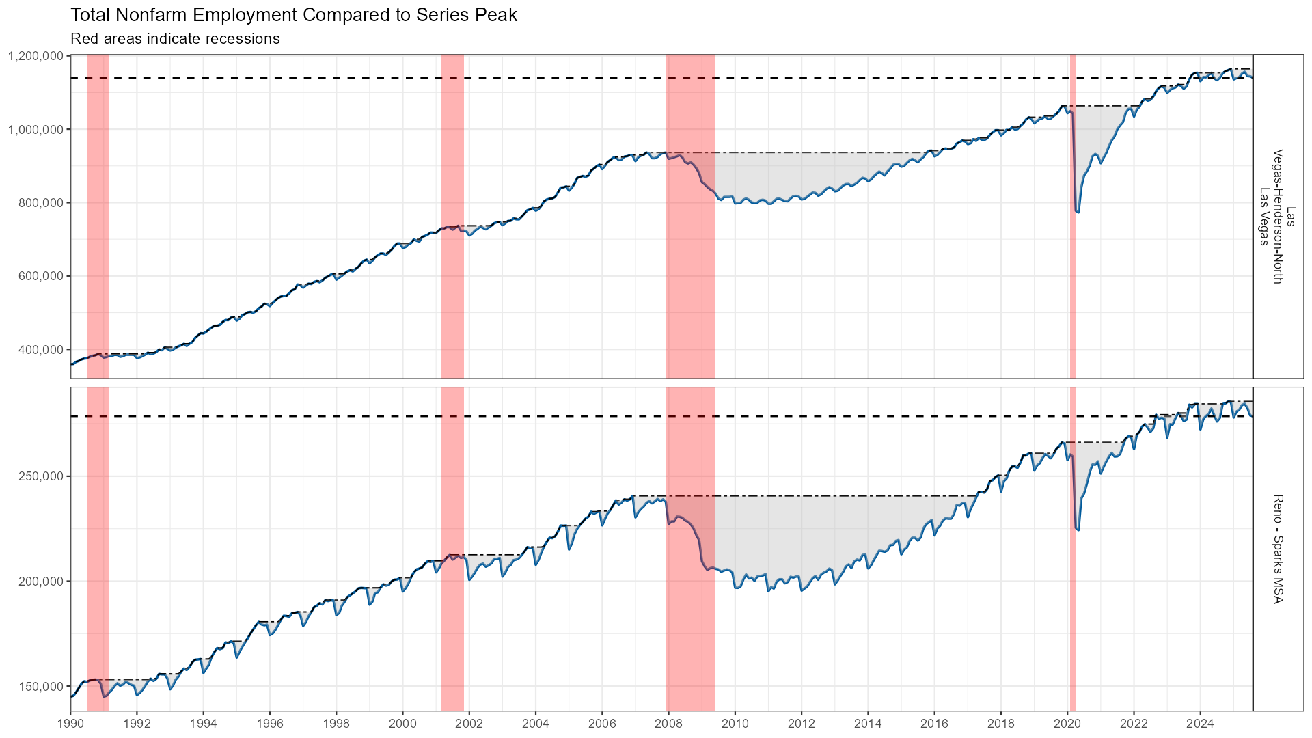
Current Employment Trends

Slide 5
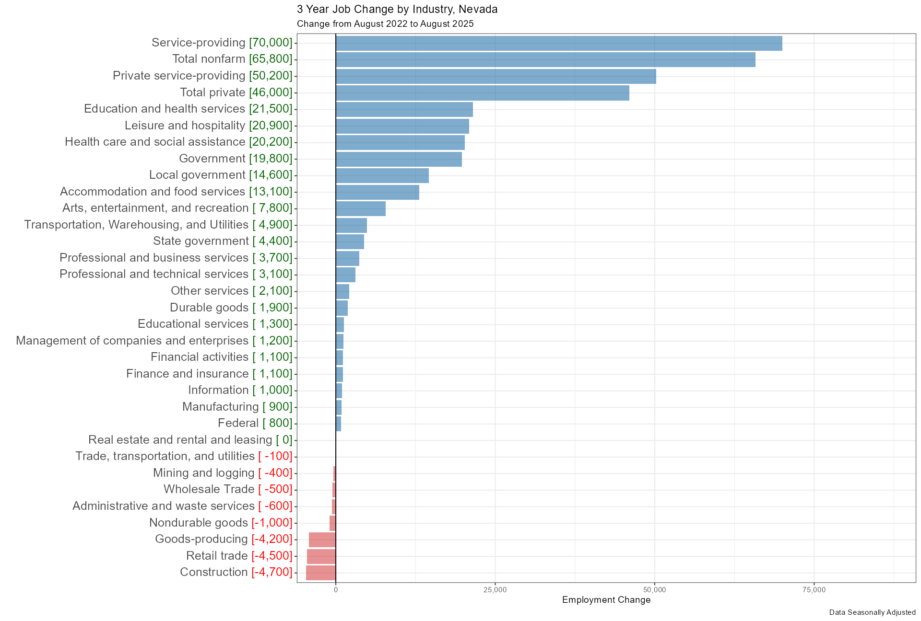
Most Industries Added Jobs 2022-2025

Slide 6
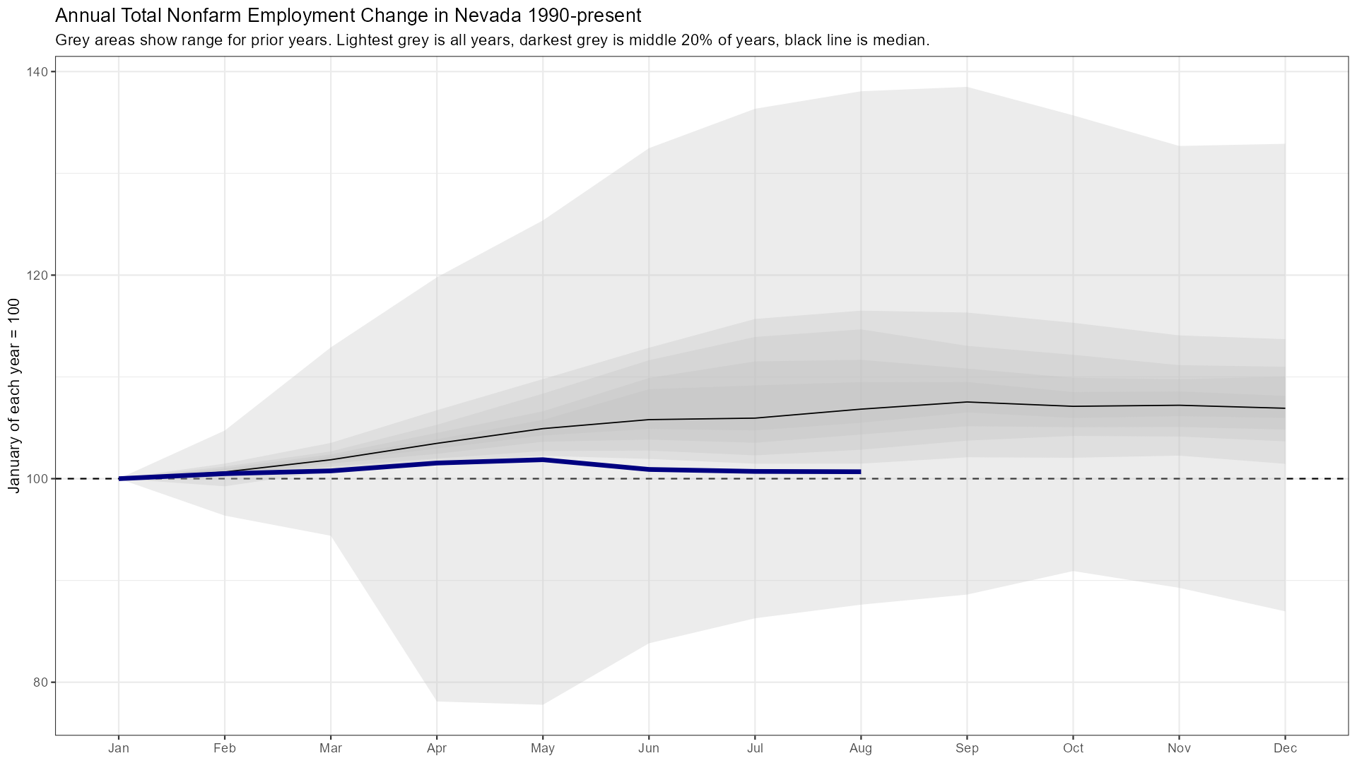
Recent Job Trends Historically Flat

Slide 7
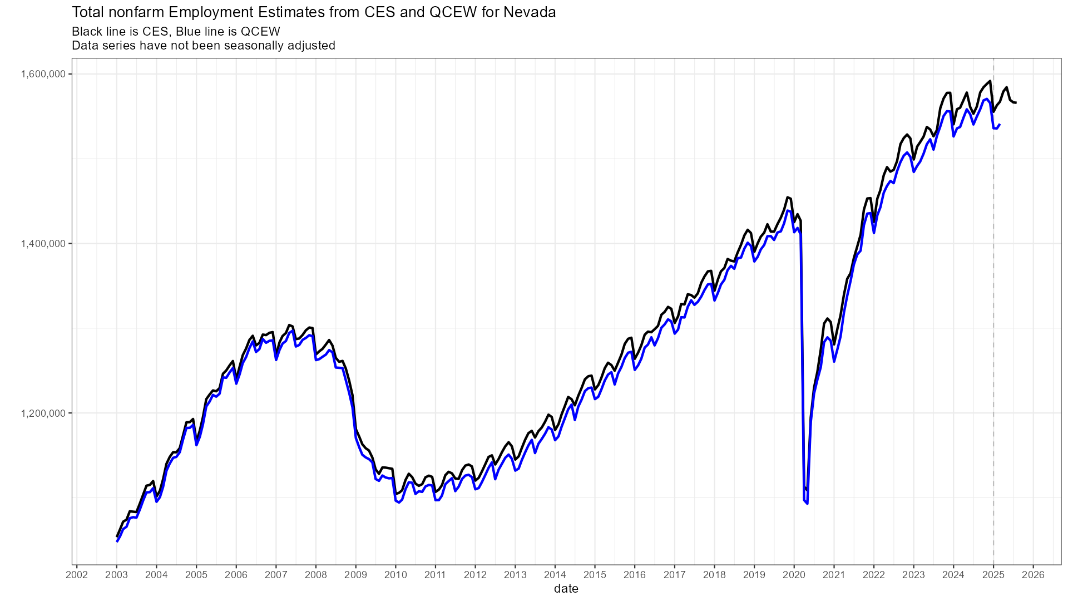
Annual Revisions Likely Negative

Slide 8
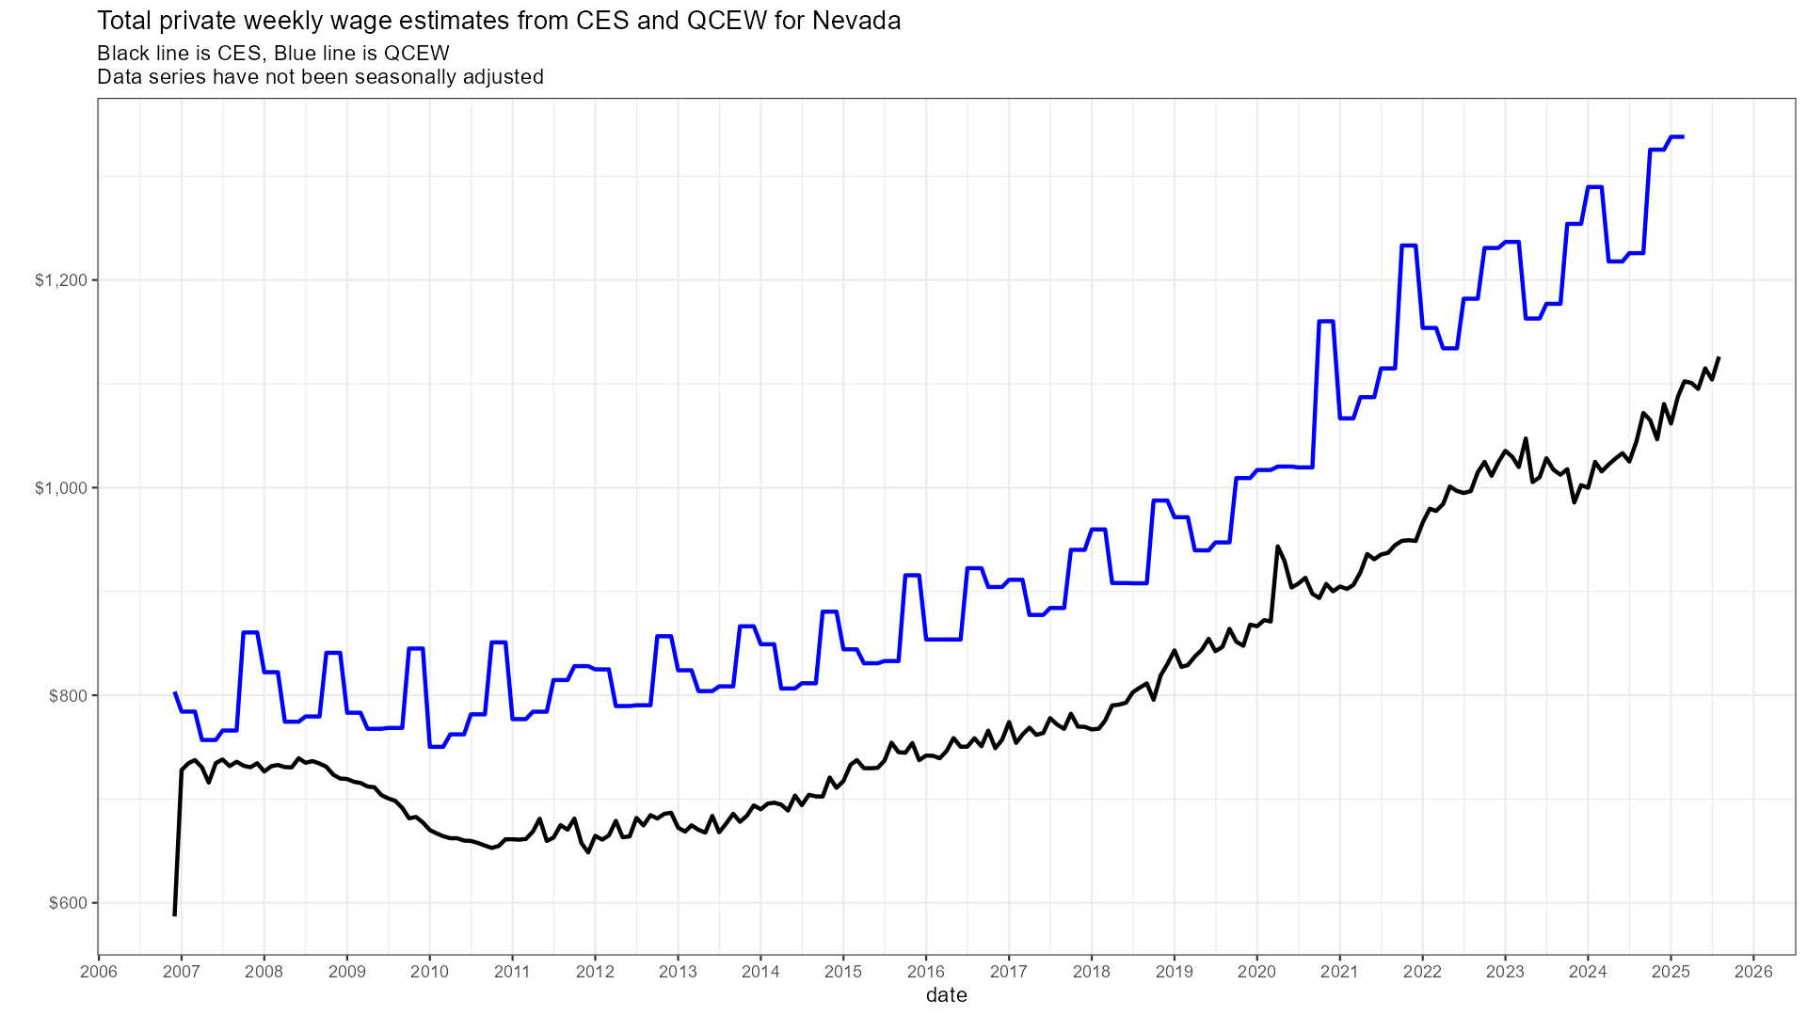
Wage Growth is Holding Up

Slide 9
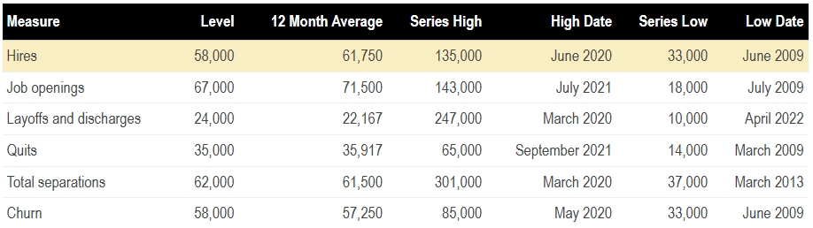
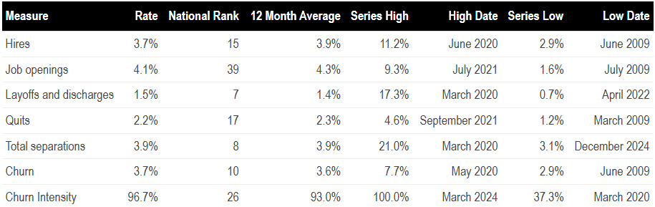
Job Turnover is Slowing

Slide 10
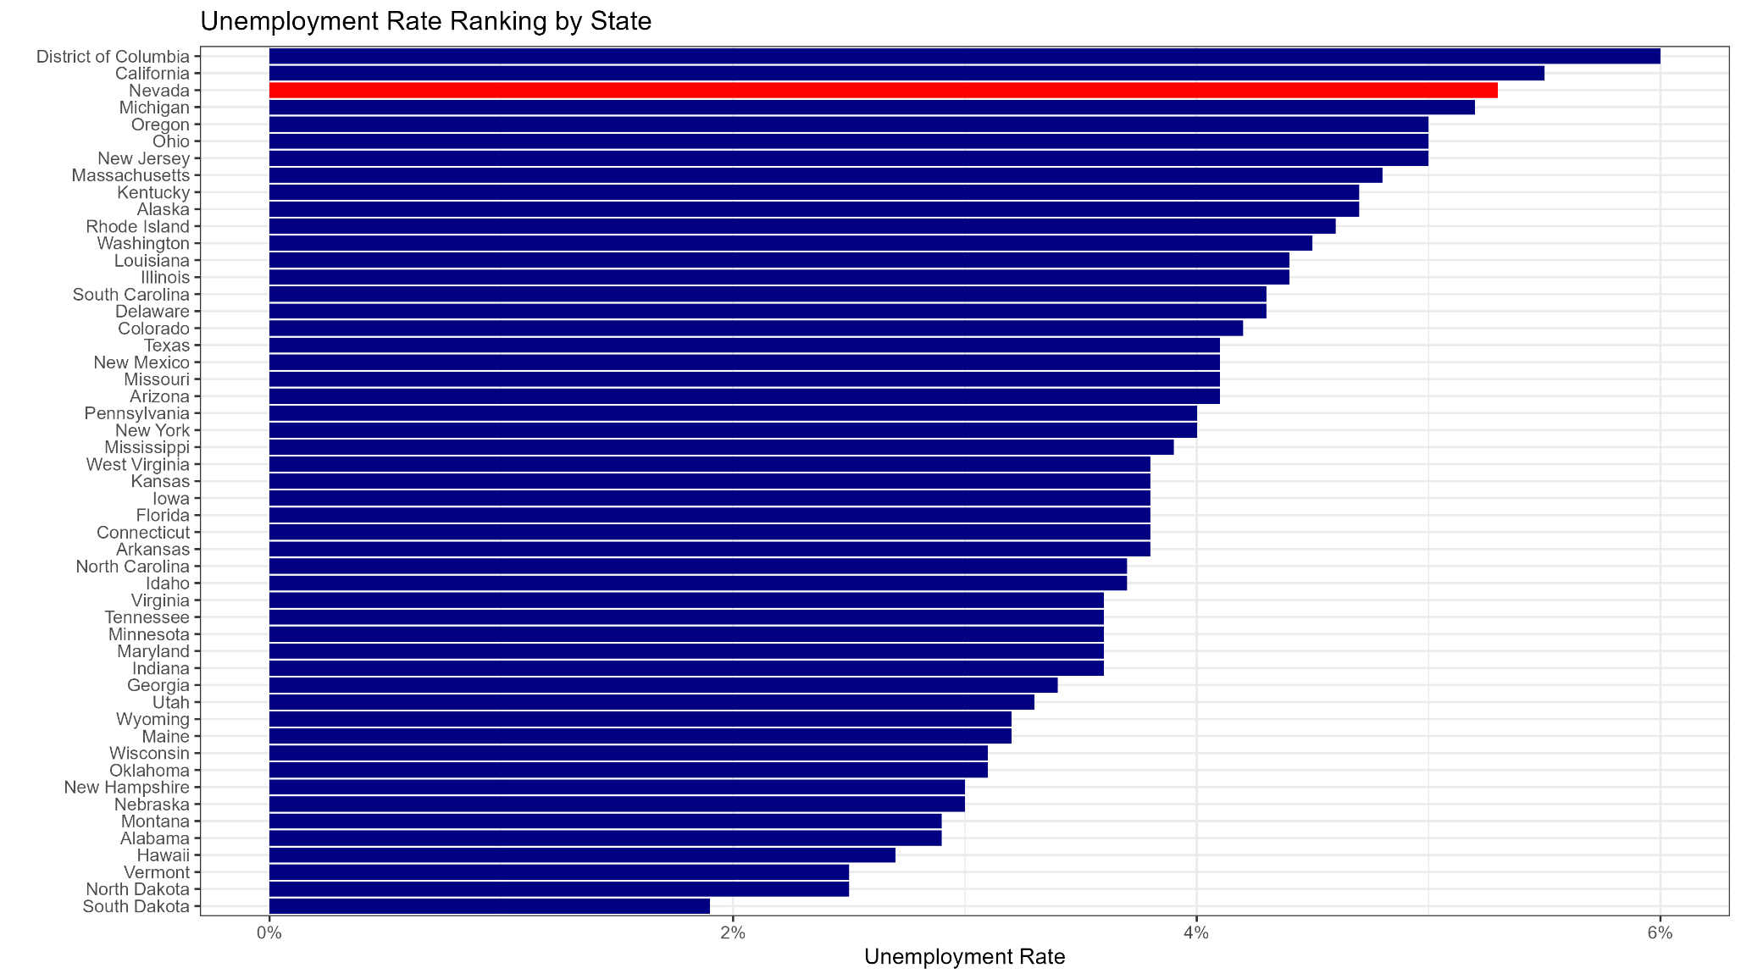
Unemployment Higher than Most States

Slide 11
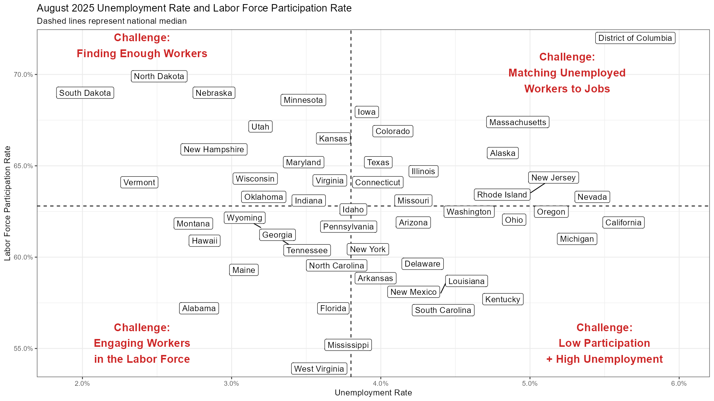
But Participation is Above-Average

Slide 12
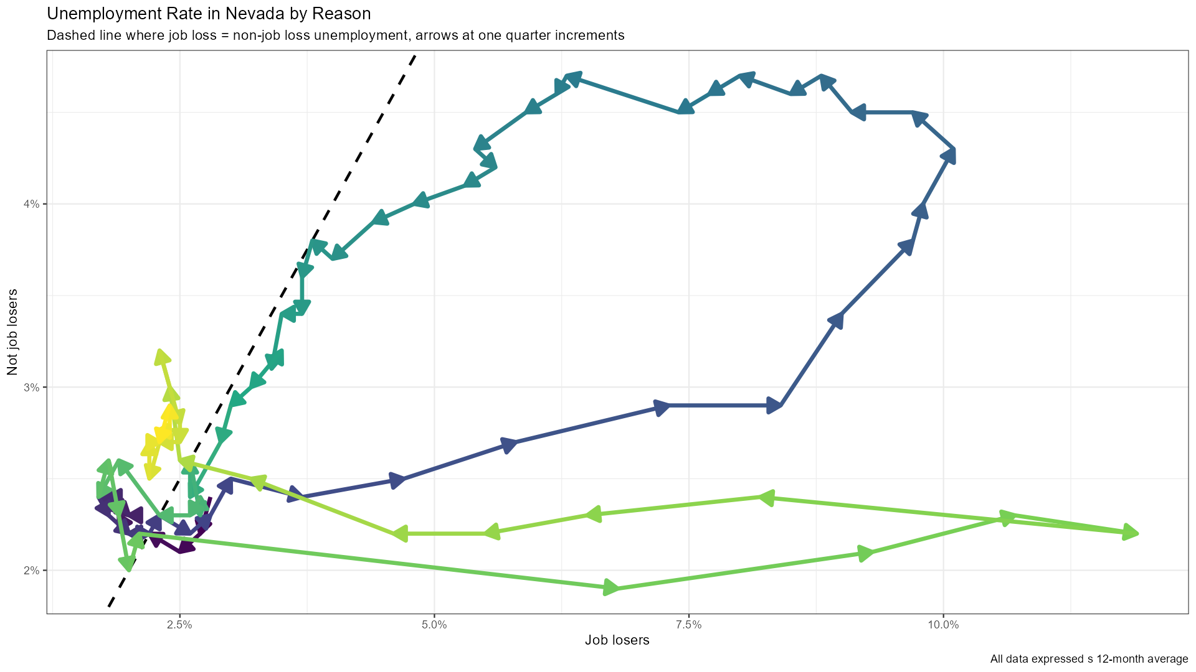
Reason for Unemployment Still Positive
Current level of unemployment not driven by job loss
Great Recession
COVID Recession

Slide 13
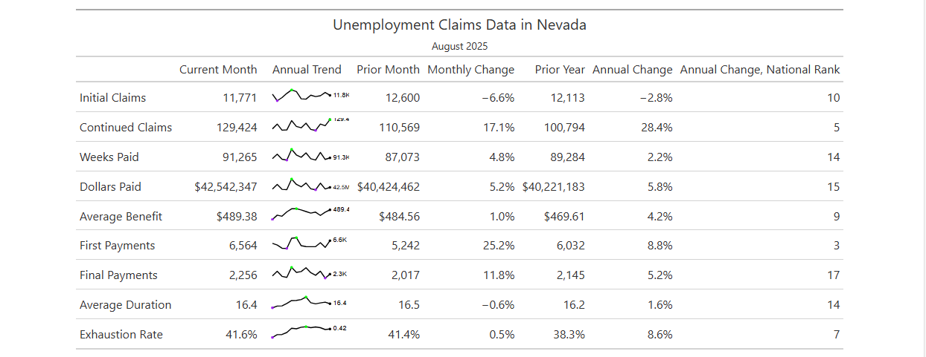
UI Duration and Exhaustions Rising

Slide 14
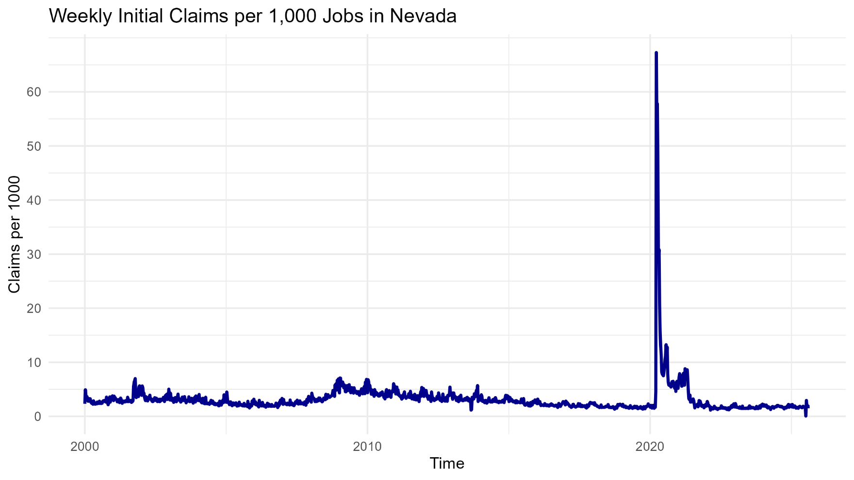
Trend in New UI Claims

Slide 15
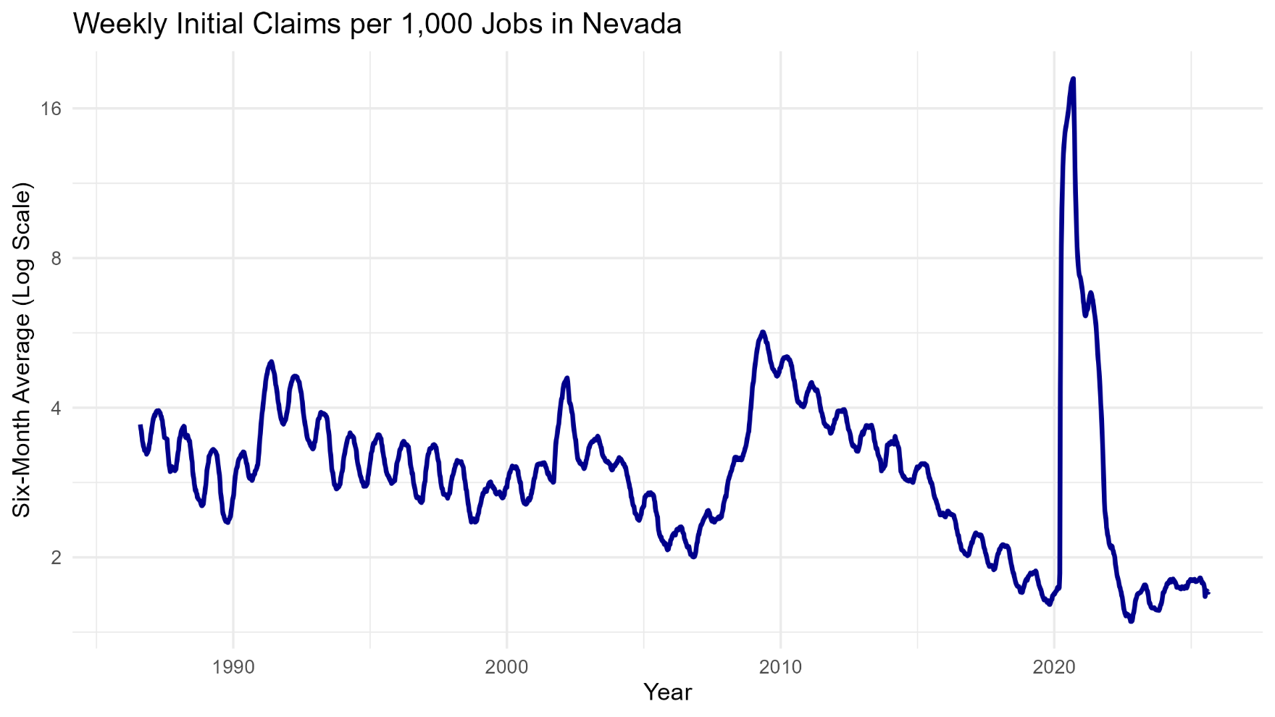
Trend in New UI Claims

Slide 16
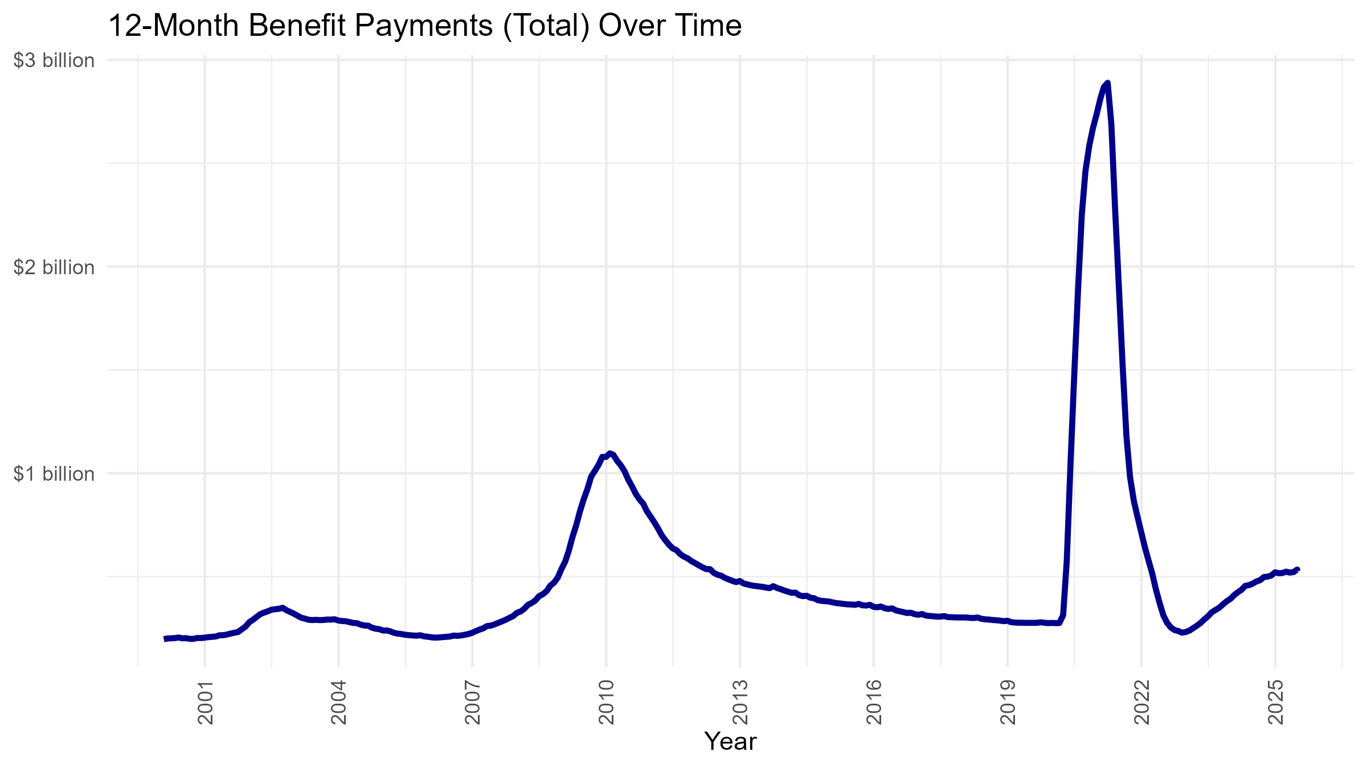
Trend in UI Benefits

Slide 17
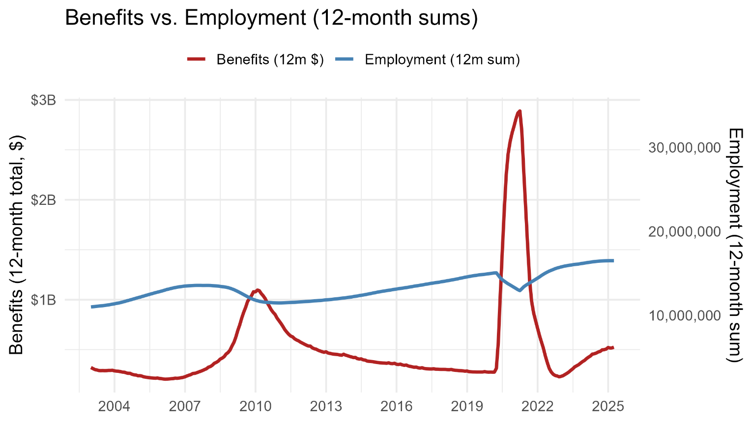
Benefits vs. Employment
In levels, employment and benefits are essentially uncorrelated (r≈−0.09). After de-trending with YoY changes, the relationship turns strongly inverse (r≈−0.63), consistent with benefits falling as employment rises, and vice versa.

Slide 18
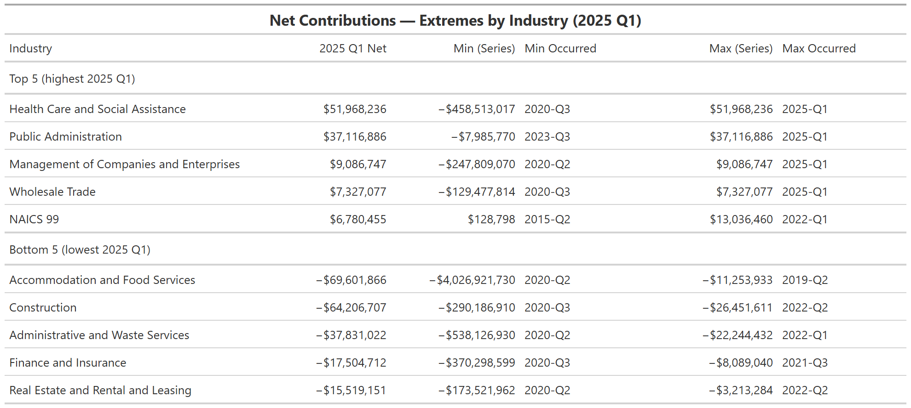
Net Contributions by Industry
Notes:
This is the breakdown of benefits paid compared to contributions for that same 2-digit industry since 2014. First, is the most recent value or 2025 quarter 1, Second is the minimum value of that industry over the series and when it occurred. Finally is the max value of this net contribution over the series and when it occurred

Slide 19
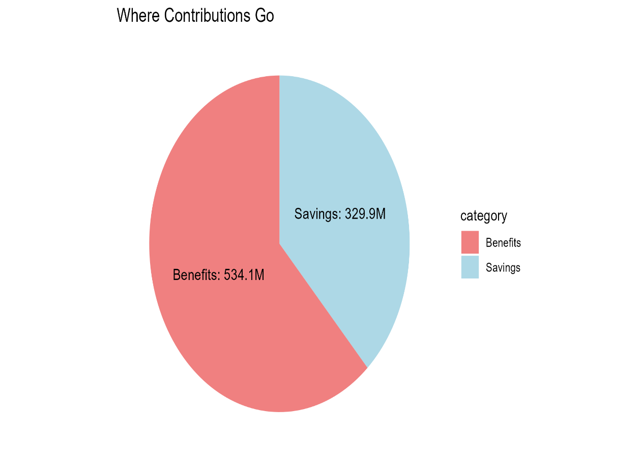
Key Statistics
Trust Fund Balance:
$1.8 billion to $2.1 billion
Average Annual Wage:
$62,786 to $65,533
Taxable Wage Base:
$41,800 to $43,700
Maximum Weekly Benefit:
$604 to $631
Where Contributions Go:

Slide 20
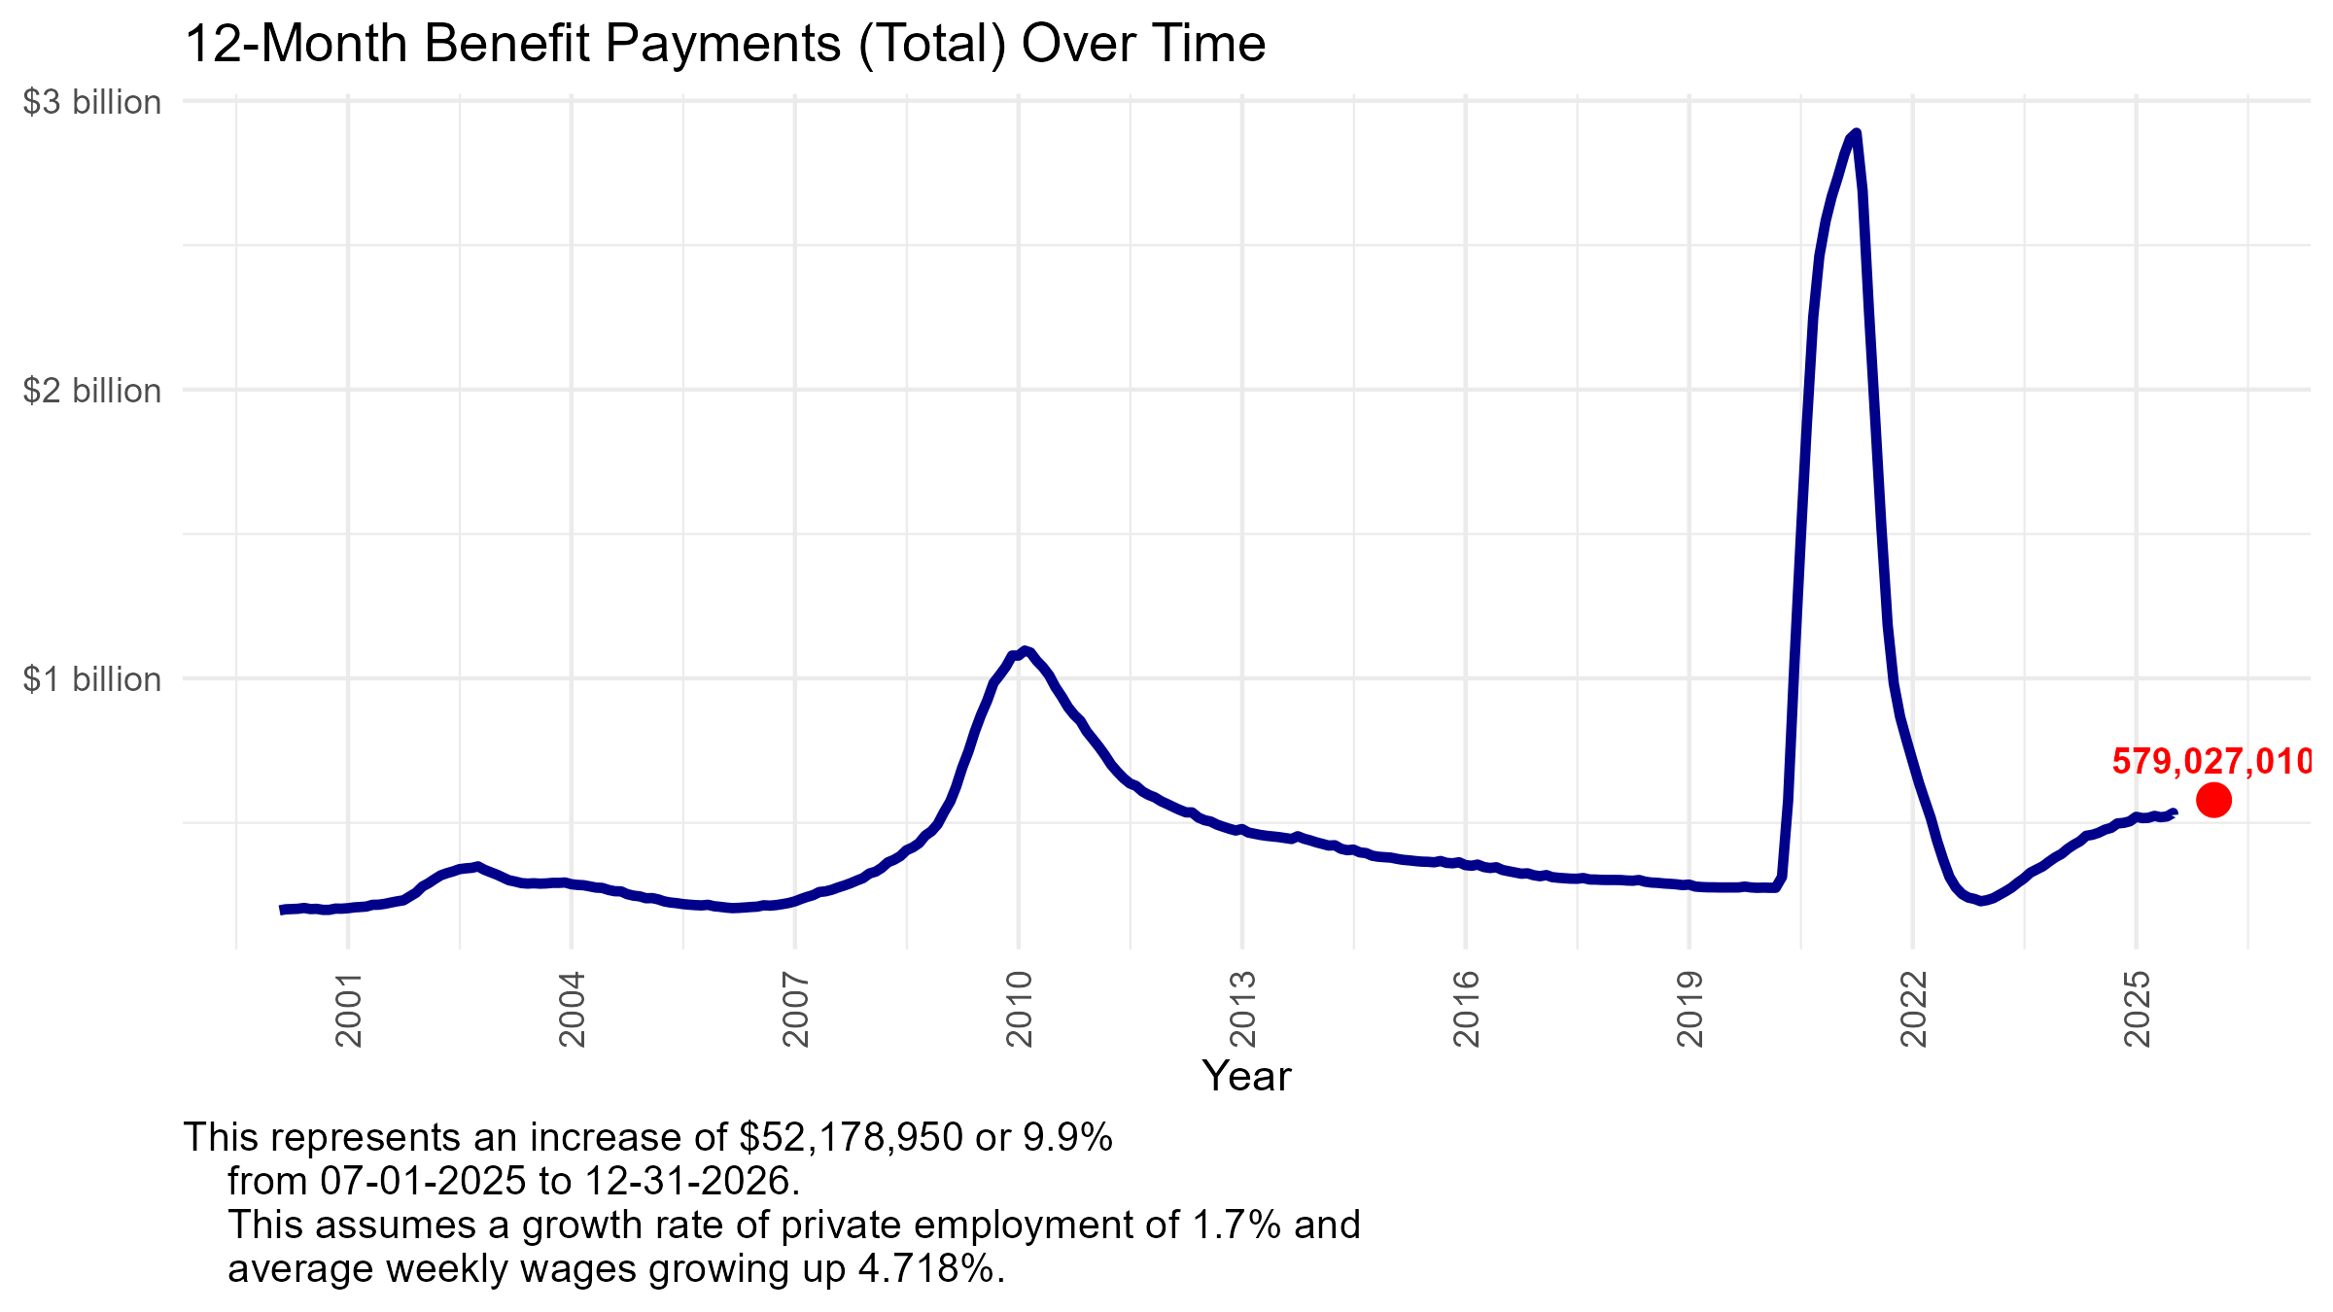
Projected Benefits

Slide 21
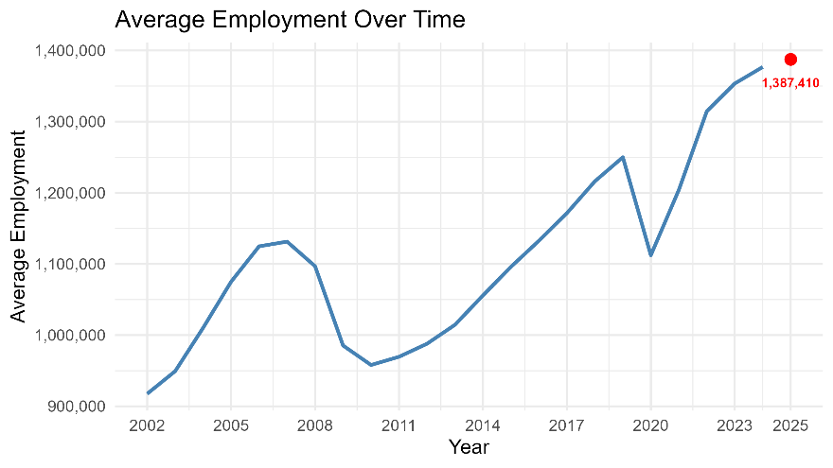
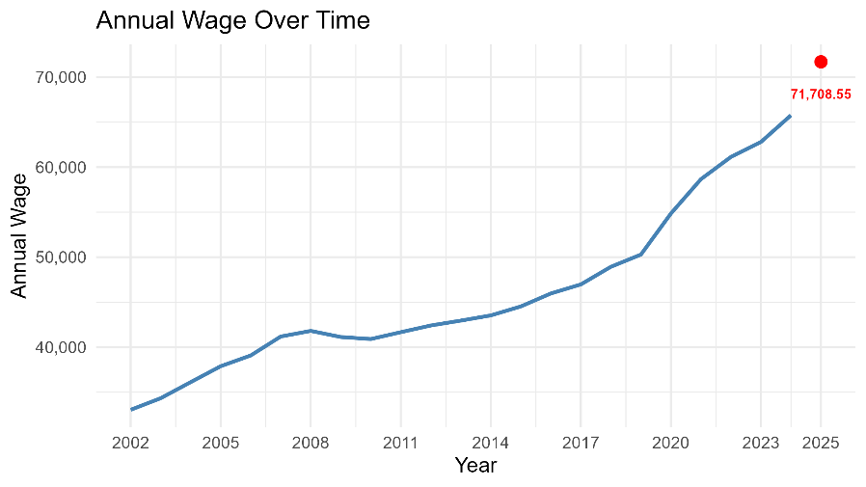
Taxable Wage Base
Modest Employment Growth and Robust Wage Growth
* Used Annual QCEW Data
Average Employment
1,376,705 (2024) to 1,387,410(2026)
Annual Wage (Total wages/ Average Employment
$65,771(2024) to $71,709 (2026)
Average ratio of taxable wages to total wages
55.52%
Forecasted value of average employment * fore-casted value of annual wage * average ratio of taxable wages to total wages =
$54,946,690,671

Slide 22
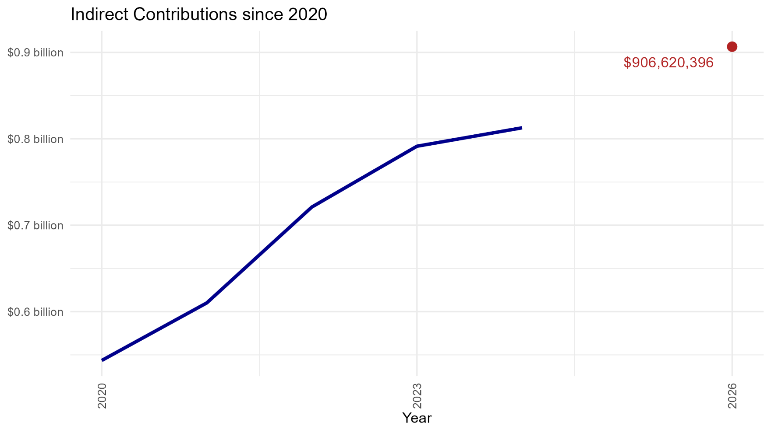
Projected Contributions (1.65% Rate)

Slide 23
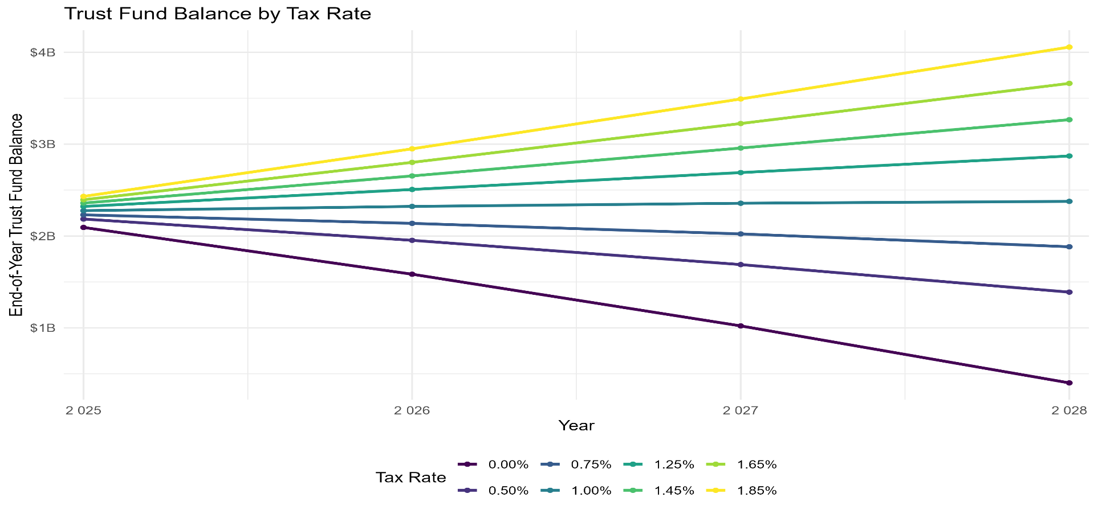
Trust Fund Impacts
Beginning Trust Fund Balance
$2,256,676,817 as of September 19, 2025
Notes:
This shows the projected balance of the trust fund given certain tax rates. The contributions values follow the same predictive model used before (change in annual wage * change in average employment * average ratio of taxwage/totalwage) for the taxable wage base. From there, we multiply it by one of the rates displayed. Benefits is calculated by last benefits value (August 1, 2025) * change in average employment * change in average weekly wage. Then use a compound growth rate. The trust fund goes up or down based on the net of these two.

Slide 24
Net Contributions by Industry
Notes:
This is the breakdown of benefits paid compared to contributions for that same 2-digit industry since 2014. First, is the most recent value or 2025 quarter 1, Second is the minimum value of that industry over the series and when it occurred. Finally is the max value of this net contribution over the series and when it occurred

Slide 25
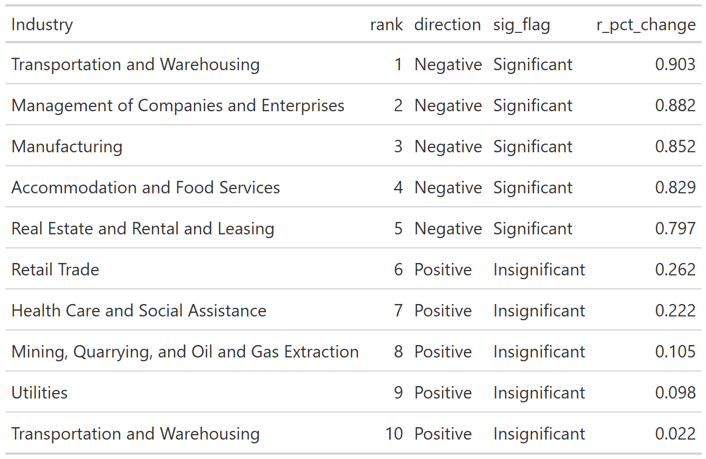
Correlation between UI Benefits paid and Employment
Notes:
Transportation & Warehousing: An r_pct_change of −0.903 means quarter-to-quarter percent changes in employment and benefits move in opposite directions almost like a mirror—when employment rises, benefits almost always fall the same quarter (and vice versa). That’s an extremely strong inverse relationship (≈82% of the ups/downs co-move inversely; $r^{2}≈0.815$).

Slide 26
Historic Cash Flows
 |  | Actual | Actual | Actual | Actual | Actual | Actual | Preliminary
 |  | 2019 | 2020 | 2021 | 2022 | 2023 | 2024 | 2025
UI Trust Fund Level: October - September
Beginning Fund Balance (Millions) |  | 1,416.30 | 1,864.60 | 291 | -76 | 795.5 | 1,412.9 | 1,742.9
Contributions |  | 674 | 617.9 | 595.6 | 752.7 | 828 | 848.3 | 920.3
Benefit Payments |  | 268.7 | 2,232.20 | 862.3 | 228 | 349.2 | 497.7 | 529.2
Other Items |  | 43.1 | 40.7 | -100.3 | 346.7 | 146.6 | 20.6 | 73.1
Net Change in Fund |  | 448.3 | -1,573.60 | -367 | 871.4 | 617.4 | 330.0 | 464.2
Ending Fund Balance (Millions) |  | 1,864.6 | 291 | -76 | 795.5 | 1,412.9 | 1,742.9 | 2,207.1
AHCM Solvency Level (Millions) |  | 657.3 | -987.2 | -1,861.6 | -1,297.9 | -1,110.1 | -856.5 | -475.7
AHCM Target (Millions) |  | 1,207.3 | 1,278.2 | 1,785.6 | 2,093.4 | 2,523.0 | 2,599.4 | 2,682.9
All-Time High Cost Multiple |  | 1.56 | 0.11 | -0.02 | 0.14 | 0.23 | 0.46 | 0.59
Average High Cost Multiple |  | 1.54 | 0.23 | -0.04 | 0.38 | 0.56 | 0.67 | 0.82
Average Tax Rate |  | 1.85% | 1.65% | 1.65% | 1.65% | 1.65% | 1.65% | 1.65%
CEP Assessment |  | 0.05% | 0.05% | 0.05% | 0.05% | 0.05% | 0.05% | 0.05%
Total Cost to Employers |  | 1.90% | 1.70% | 1.70% | 1.70% | 1.70% | 1.70% | 1.70%
Average Cost per Employee at Max Taxable Wage (excl FUTA & Interest) |  | $592.80 | $552.50 | $567.80 | $622.20 | $681.70 | $690.20 | $710.60
Taxable Wage Base |  | $31,200 | $32,500 | $33,400 | $36,600 | $40,100 | $40,600 | $41,800
Without COVID, we’d be at an AHCM of 1.18, or around $350 million above solvency level.

Slide 27
Projected Cash Flows
 |  | 1.45% Forecast | 1.65% Forecast | 1.0 AHCM Forecast
 |  | 2026 | 2026 | 2026
UI Trust Fund Level: October - September
Beginning Fund Balance (Millions) |  | $2,207.1 | $2,207.1 | $2,207.1
Contributions |  | 796.7 | 906.6 | 1,016.3
Benefit Payments |  | 576.0 | 576.0 | 576.0
Other Items |  | 40.2 | 41.1 | 42.0
Net Change in Fund |  | 260.9 | 371.7 | 482.3
Ending Fund Balance (Millions) |  | $2,468.0 | $2,578.8 | $2,689.4
Solvency Level (Millions) |  | -$221.4 | -$110.6 | -
All-Time High Cost Multiple |  | 0.66 | 0.69 | 0.72
Average High Cost Multiple |  | 0.92 | 0.96 | 1.0
Non-COVID AHCM |  | 1.32 | 1.38 | 1.44
Average Tax Rate |  | 1.45% | 1.65% | 1.85%
CEP Assessment |  | 0.05% | 0.05% | 0.05%
Total Cost to Employers |  | 1.50% | 1.70% | 1.90%
Average Cost per Employee at Max Taxable Wage (excl FUTA & Interest) |  | $655.50 | $742.90 | $830.30
Taxable Wage Base |  | $43,700 | $43,700 | $43,700

