Slide 1
Nevada’s Employment Outlook and UI Trust Fund Forecast
Presentation to Small Business Workshop
September 30, 2024

Slide 2
Overall Conditions Through August
Employment
Current: 3.0%
2024 range: 3.0 – 3.7%
National rank: 4th
Unemployment
Current: 5.5%
2024 range: 5.1 – 5.5%
National rank: 2nd
Participation Rate
Current: 62.7%
2024 range: 62.7 – 62.8%
National rank: 29th
Hourly Wages
Current: 3.6%
2024 range: 1.2 – 3.6%
National rank: 25th

Slide 3
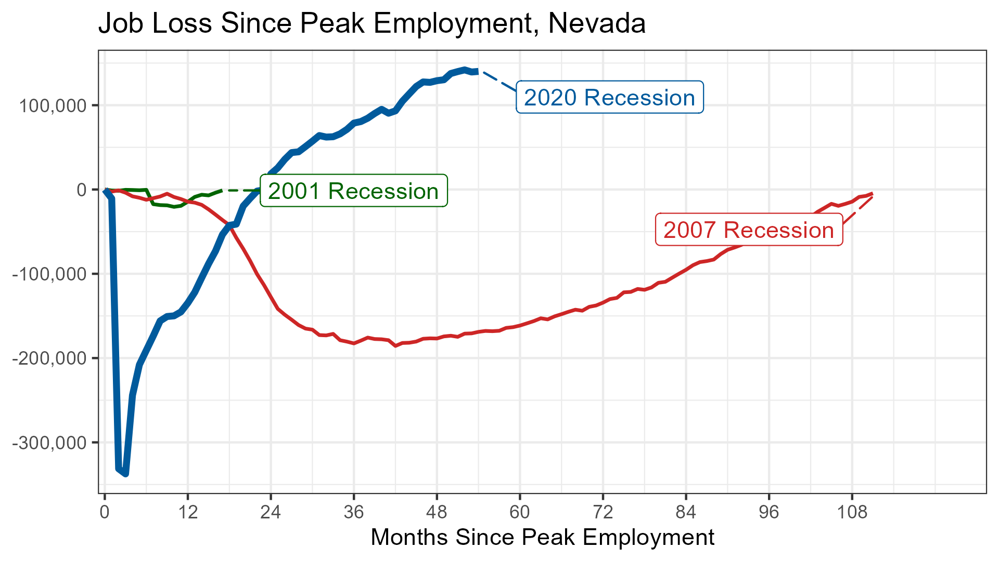
Growing Steadily After Recovery

Slide 4
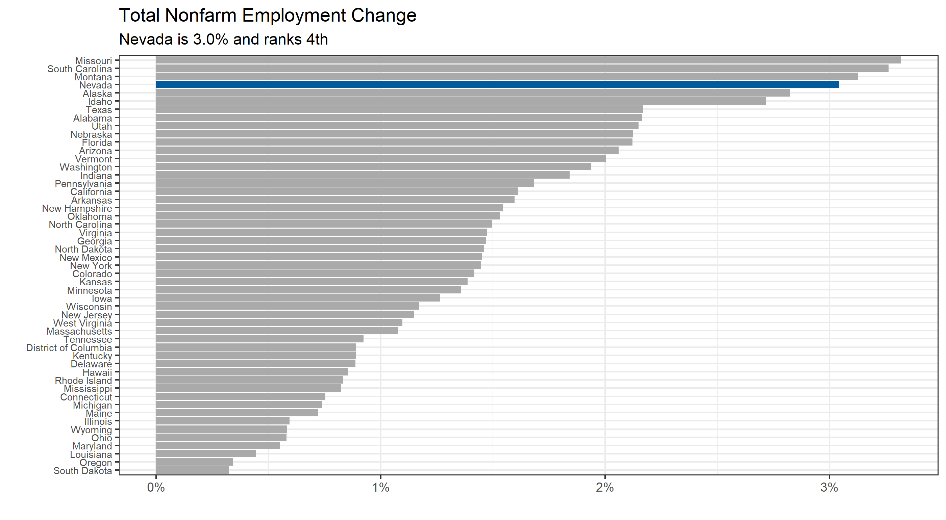
Maintaining Relatively Strong Growth

Slide 5
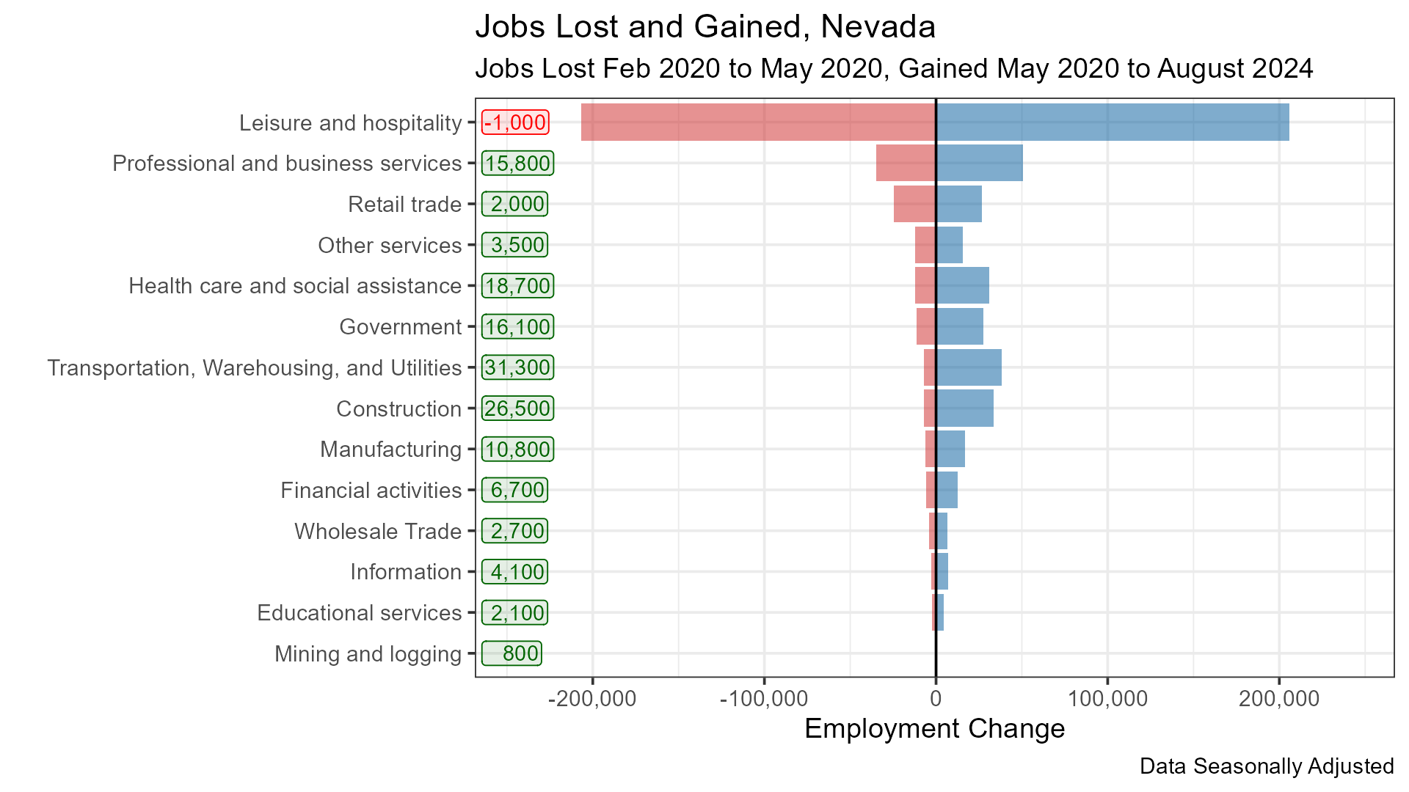
Most Sectors Showing Growth

Slide 6
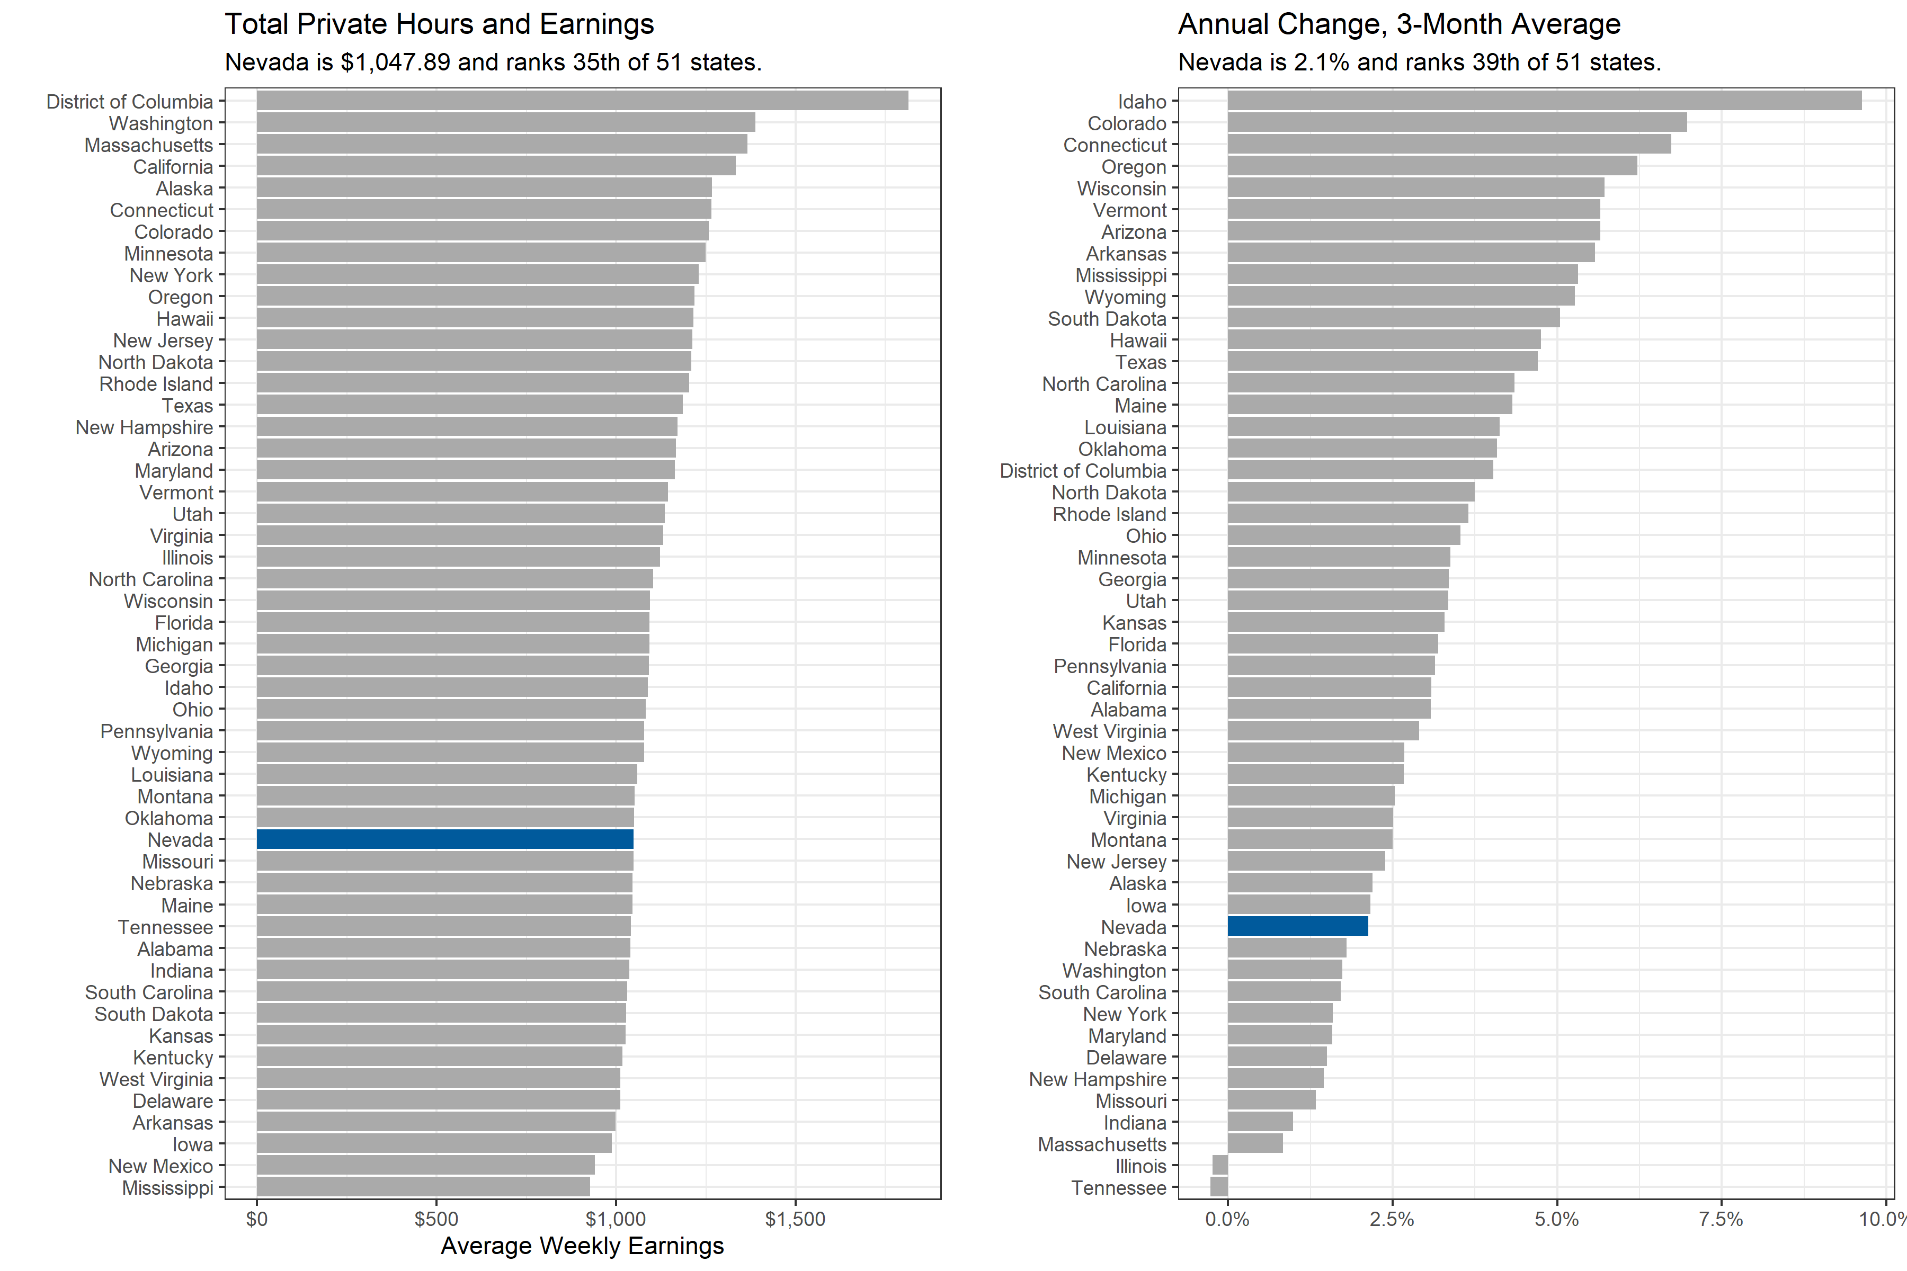
Total Weekly Earnings Rising

Slide 7
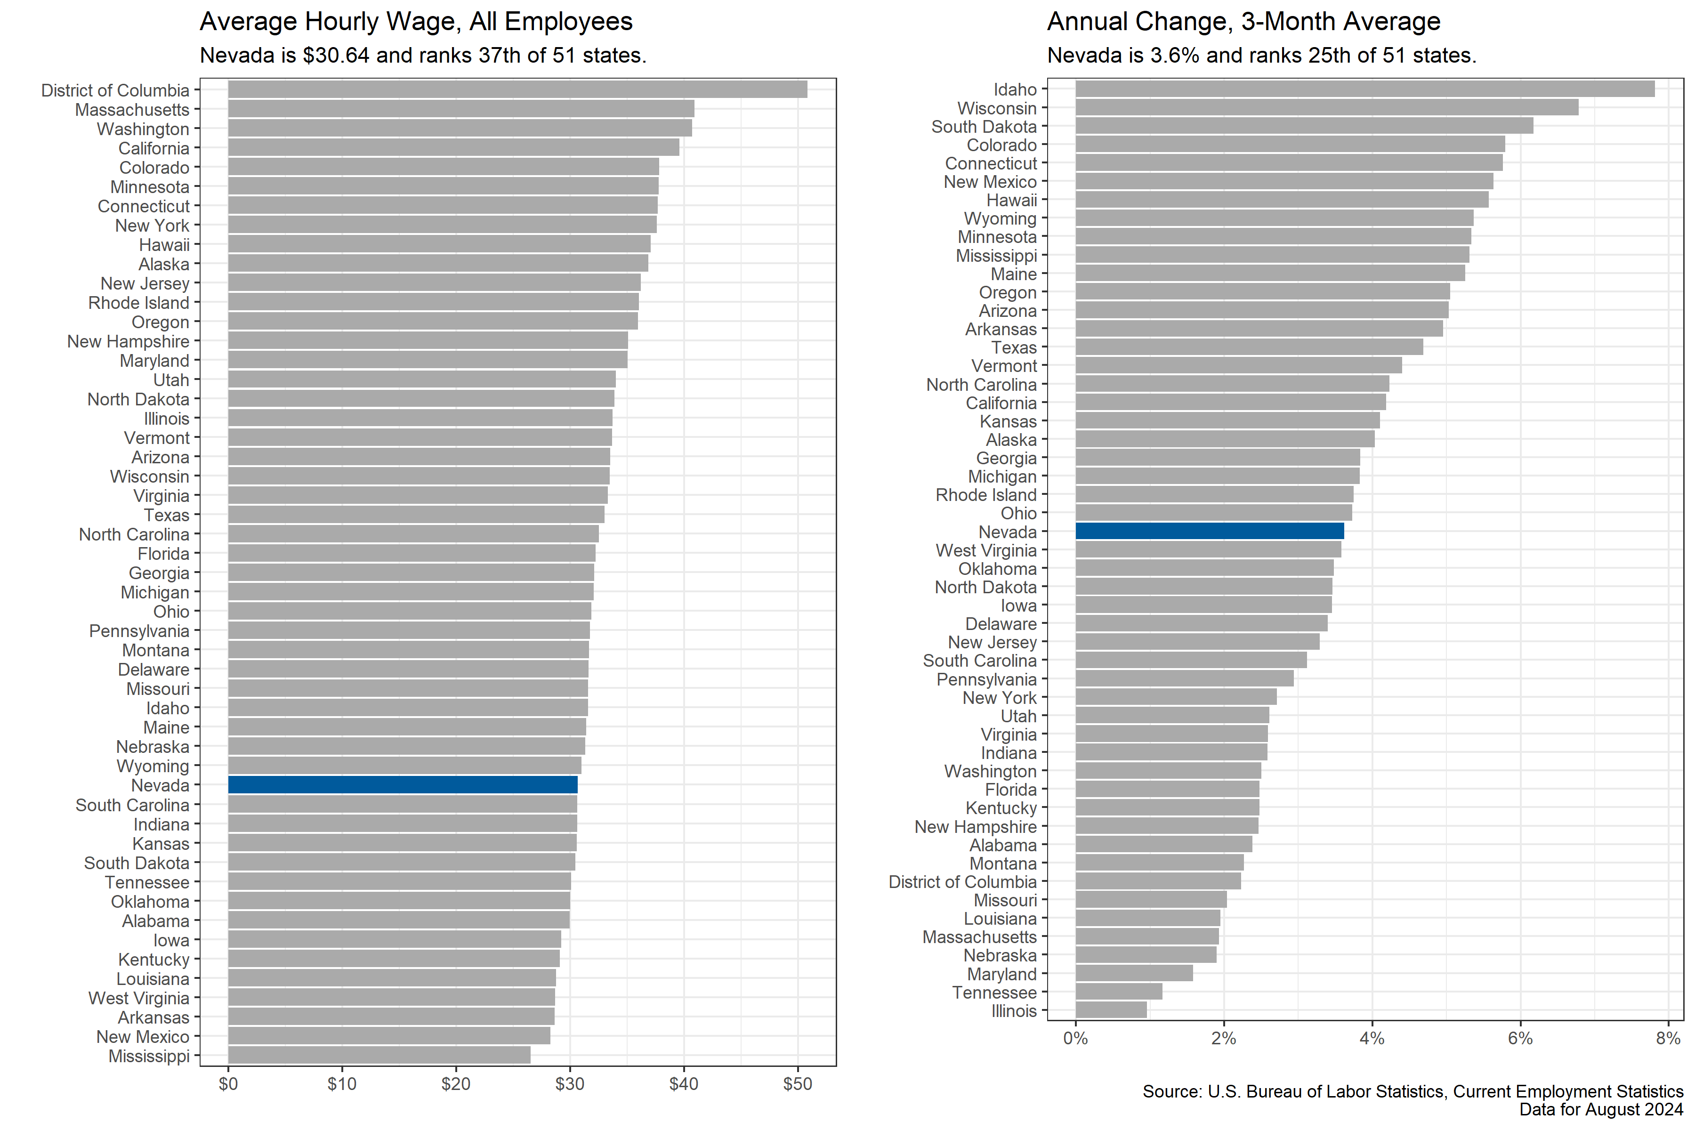
Hourly Wages Growing at Rising Pace

Slide 8
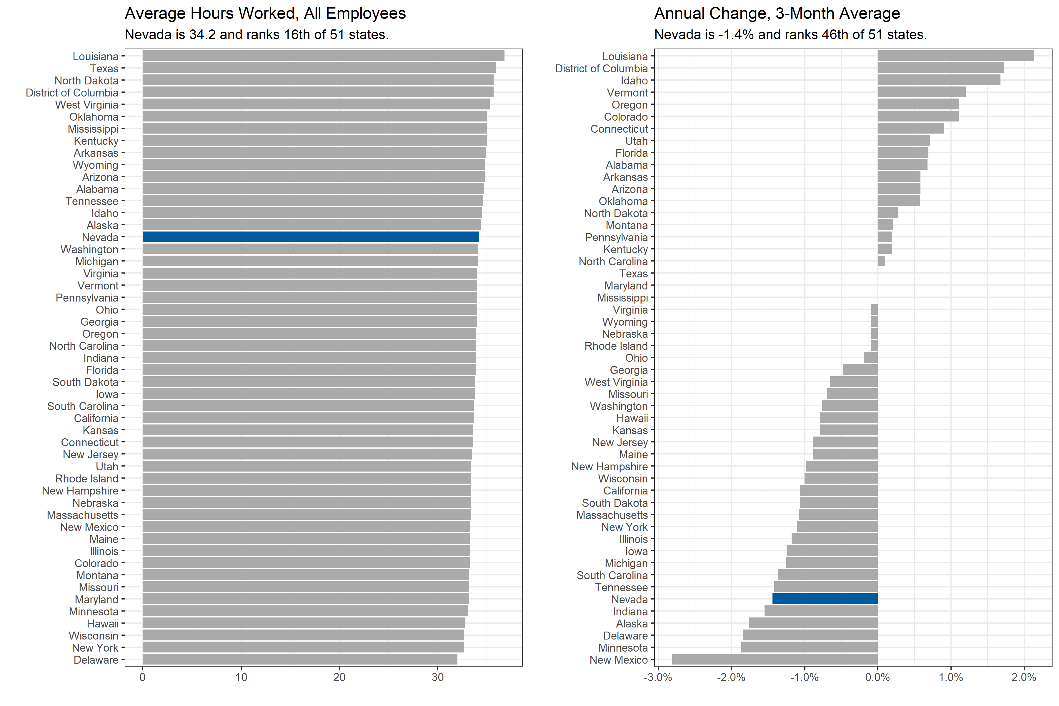
Hours Worked Offsetting Some Wage Gains

Slide 9
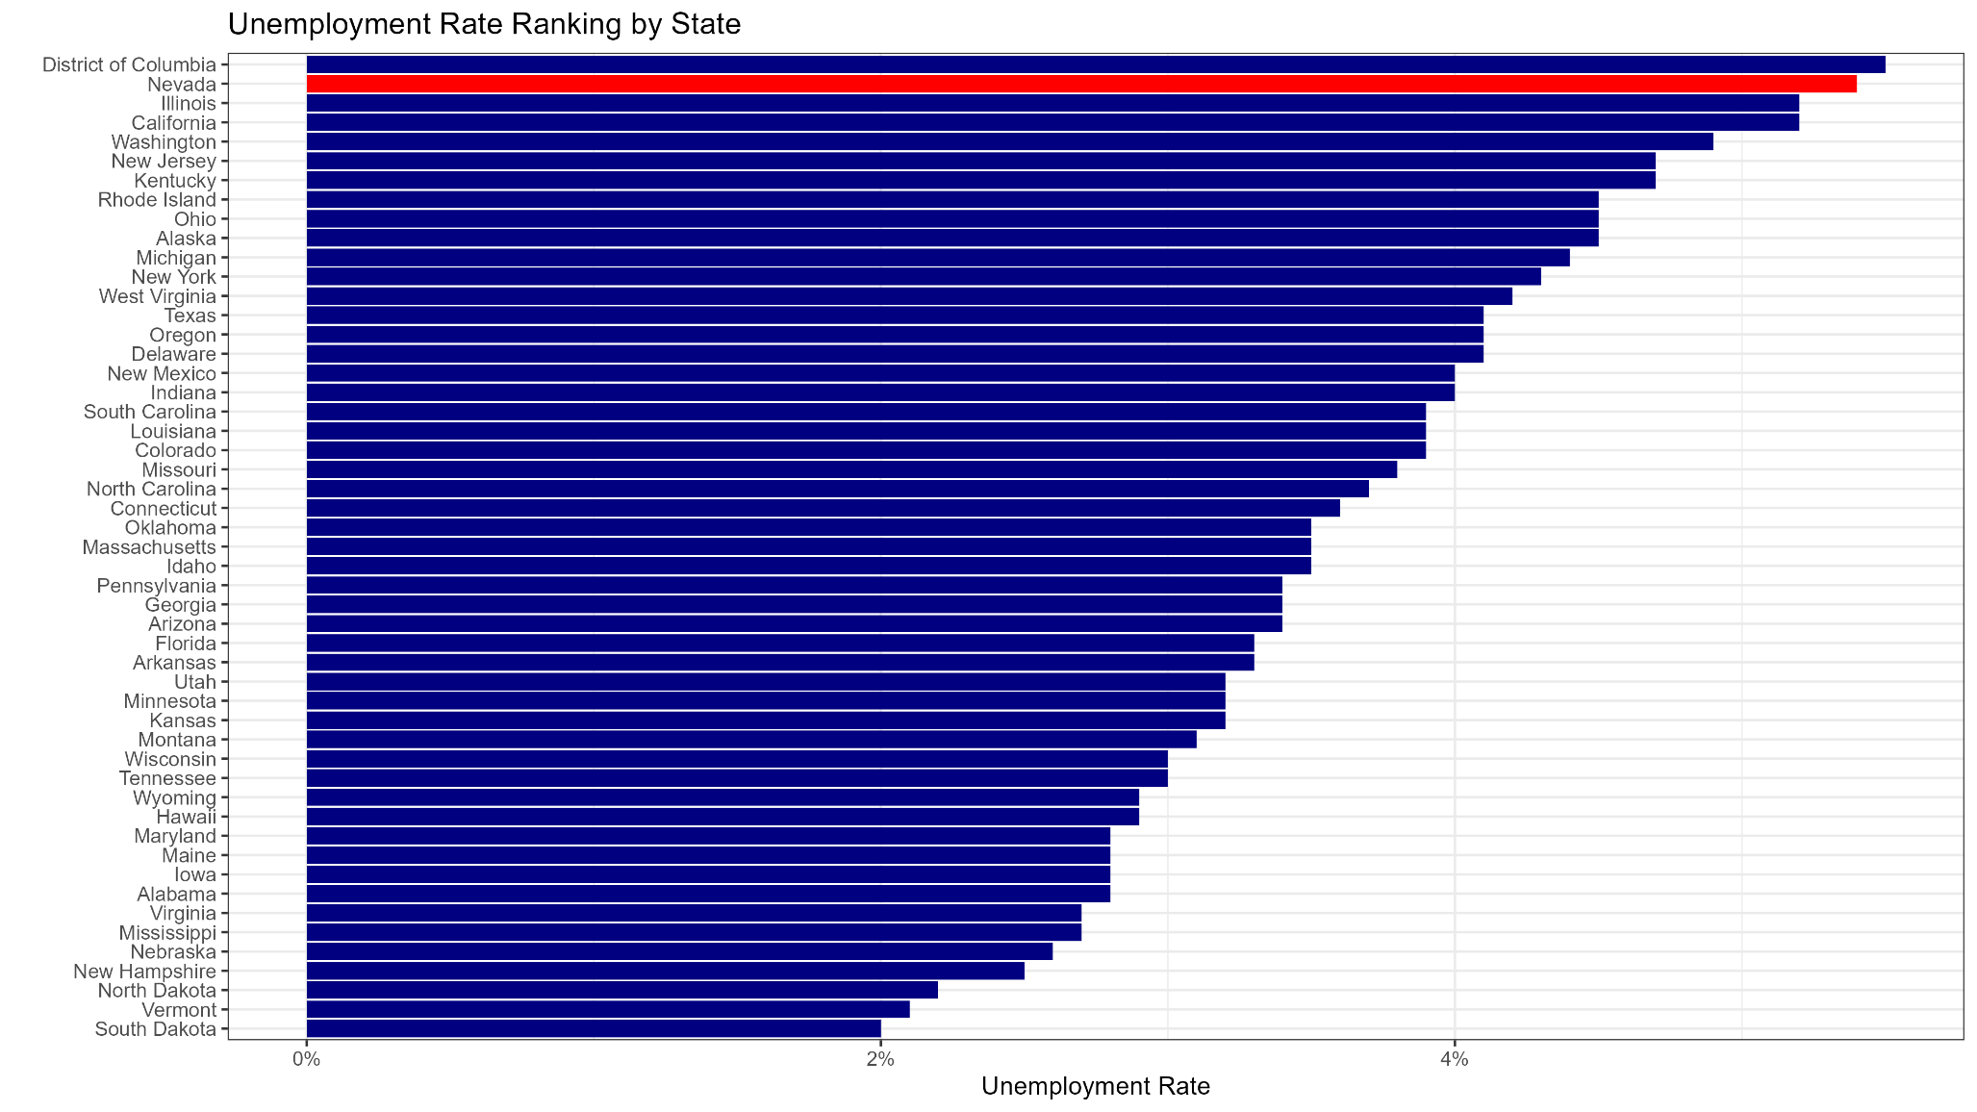
Unemployment is Elevated

Slide 10
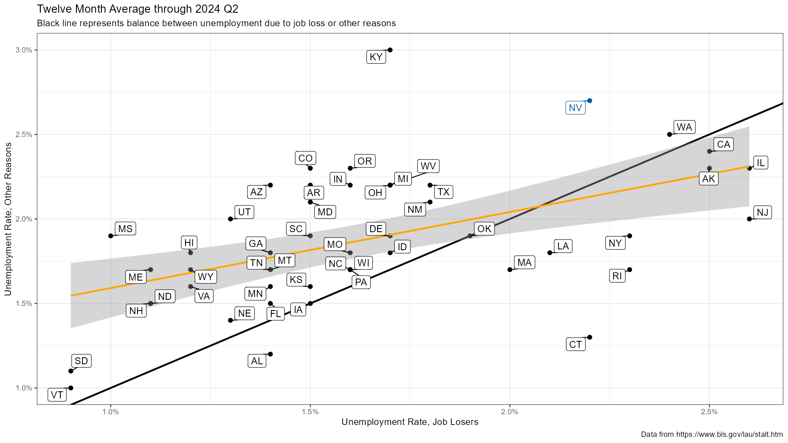
Most Unemployment not from Job Loss

Slide 11
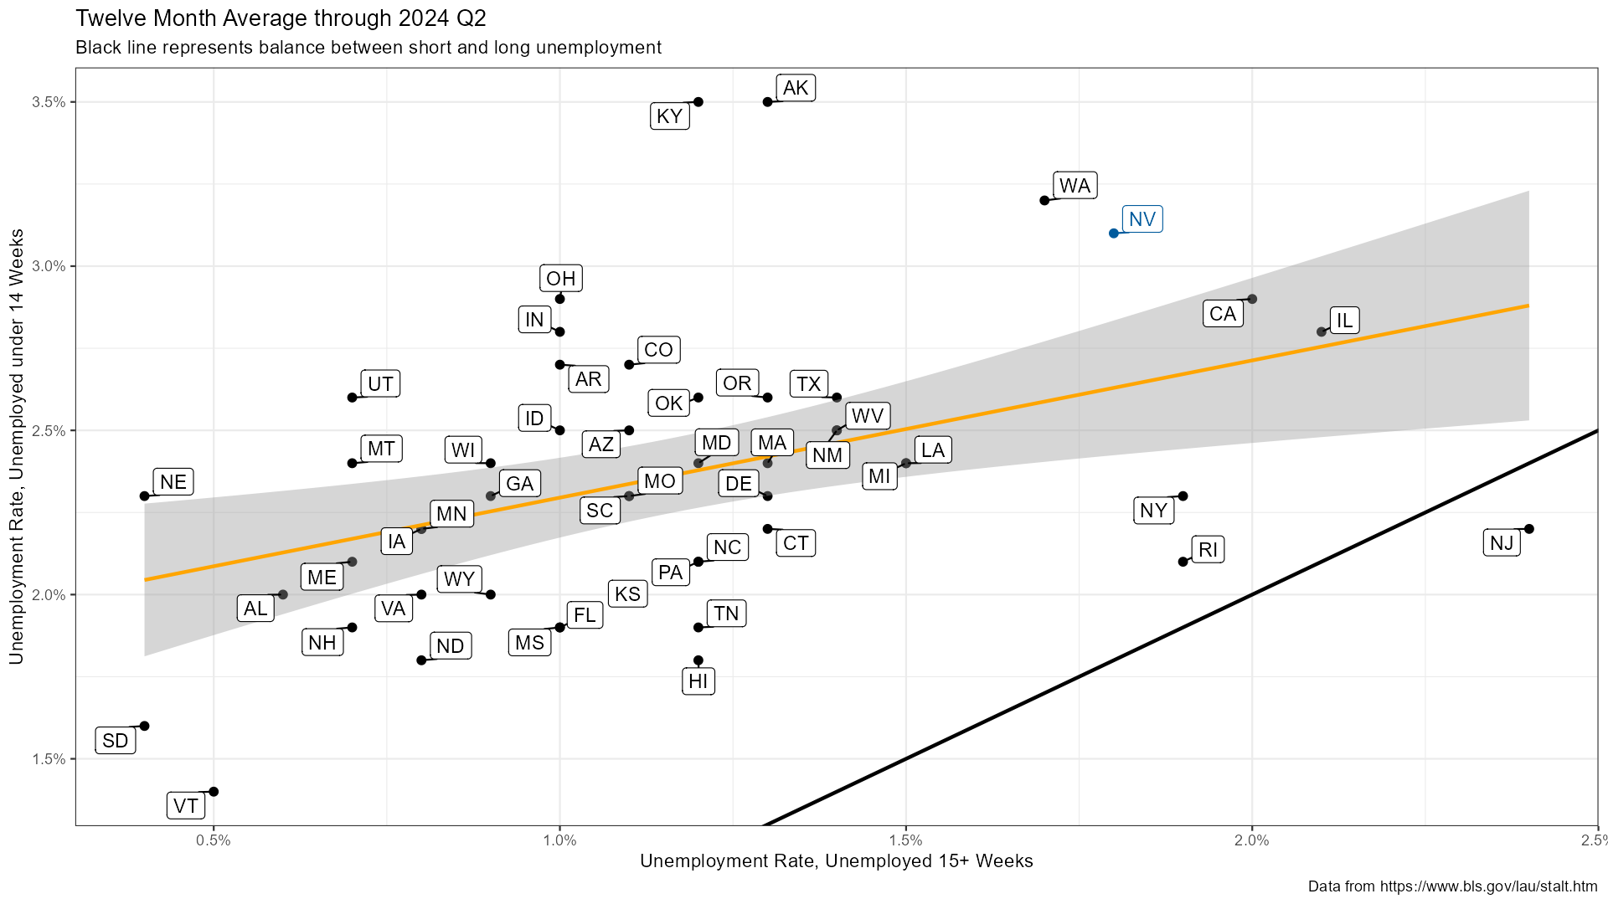
Most Unemployment Under 14 Weeks

Slide 12
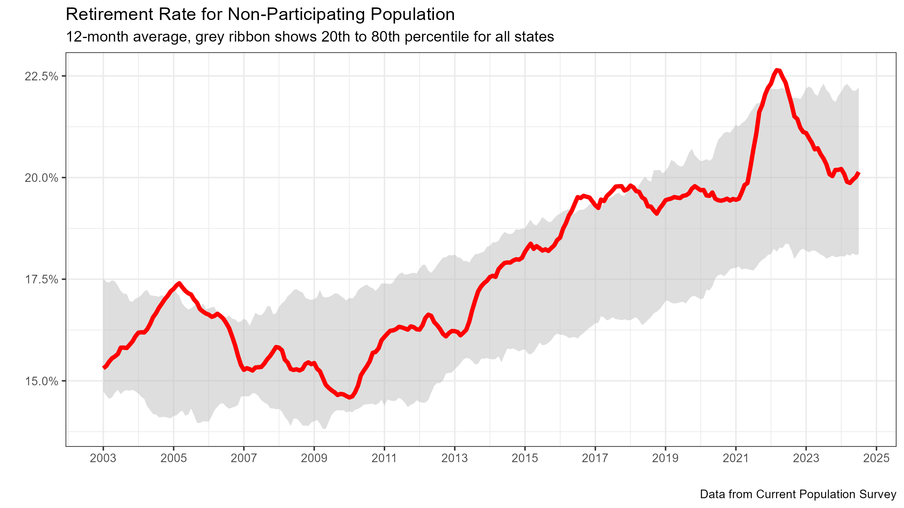
Retirement Rate is Stable

Slide 13
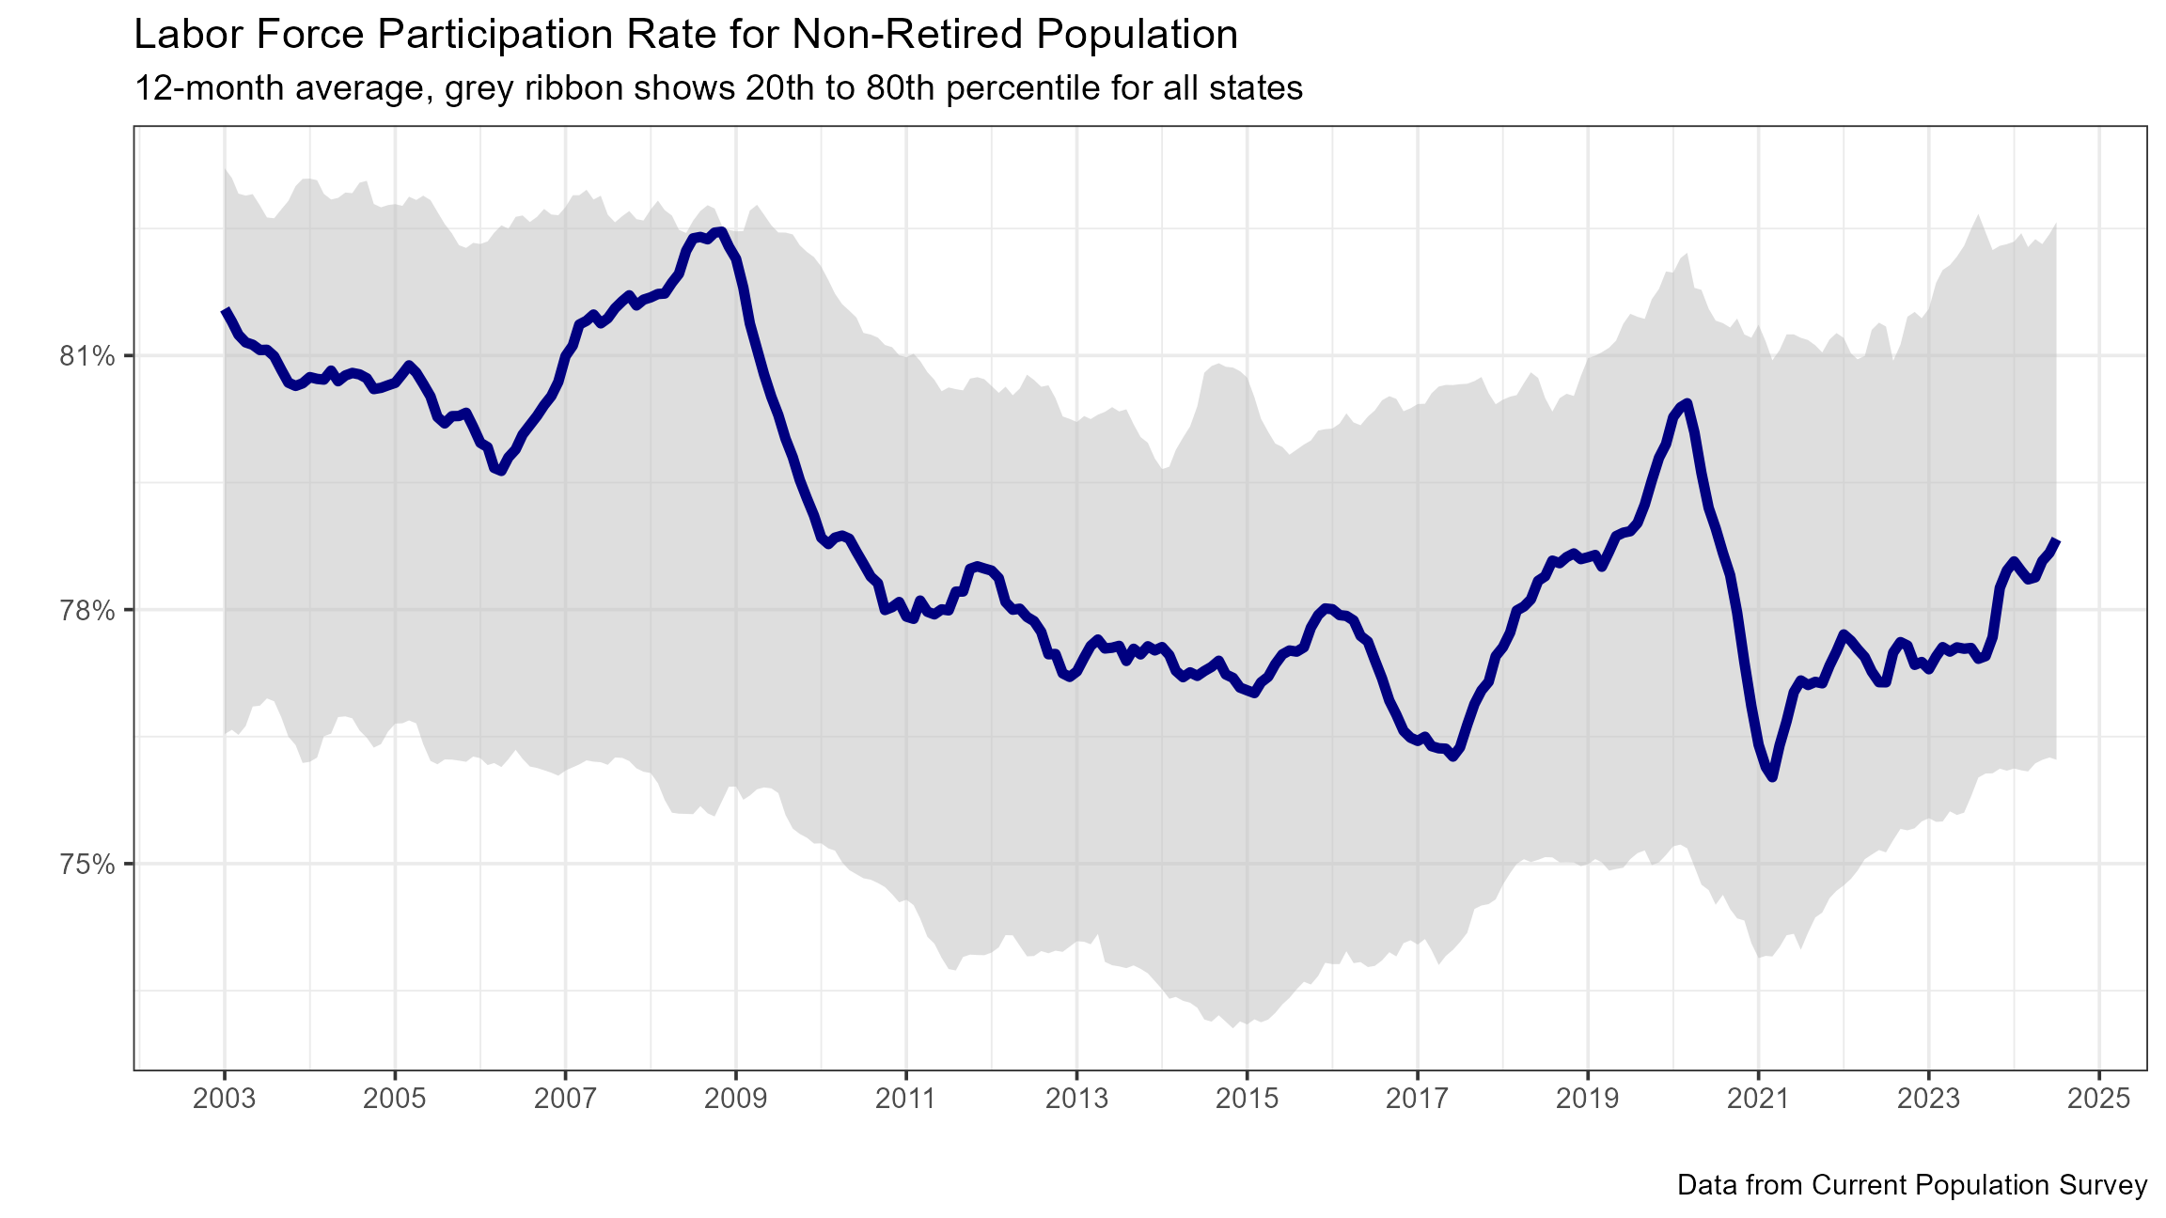
Participation Excluding Retirement is Rising

Slide 14
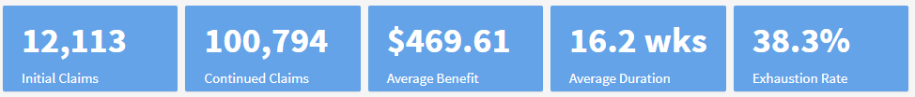
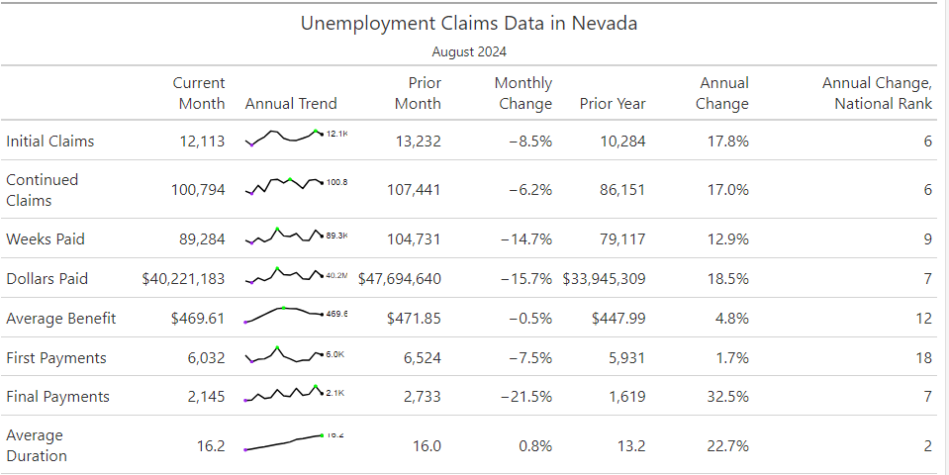
UI Duration and Exhaustions Rising

Slide 15
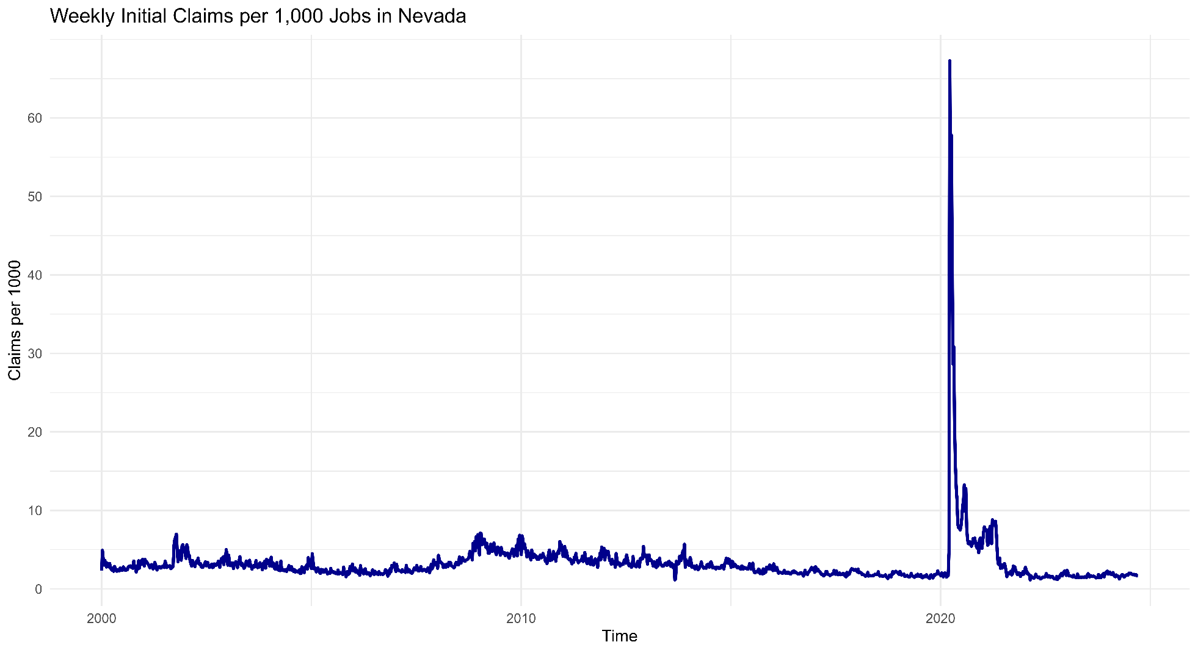
Trend in New UI Claims

Slide 16
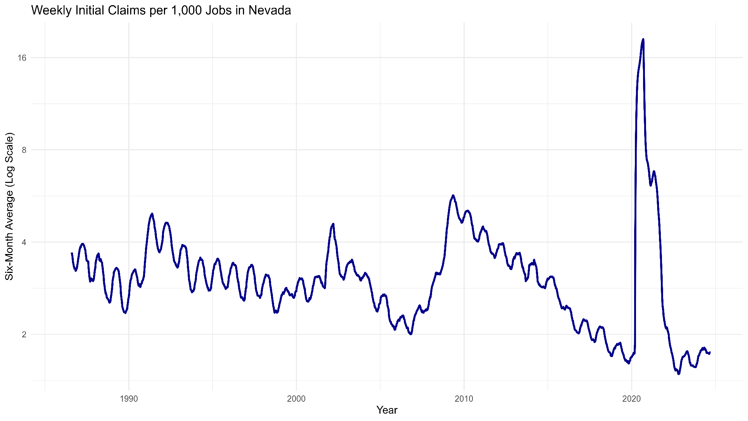
Trend in New UI Claims

Slide 17
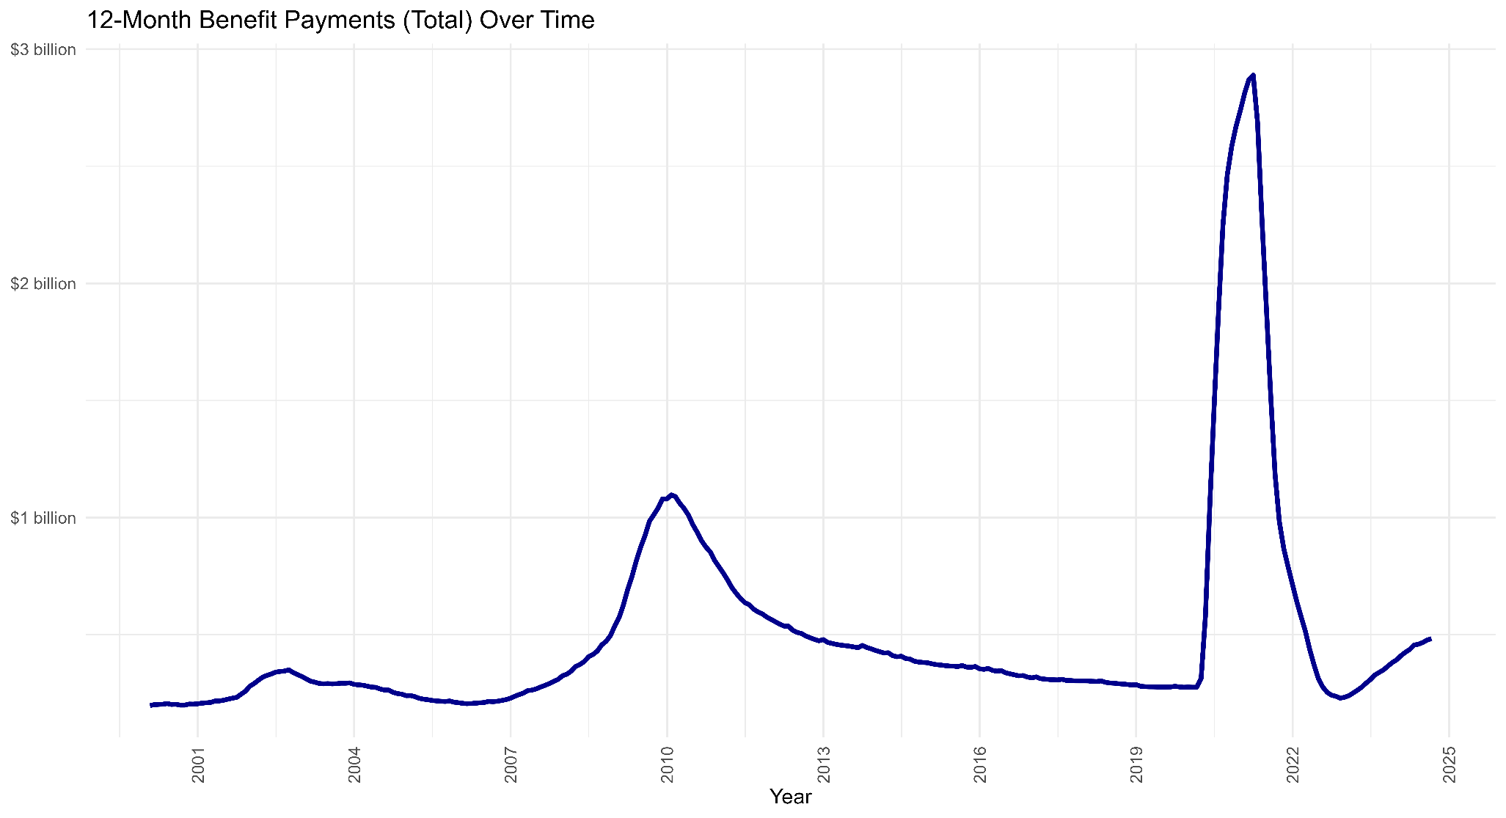
Trend in UI Benefits

Slide 18
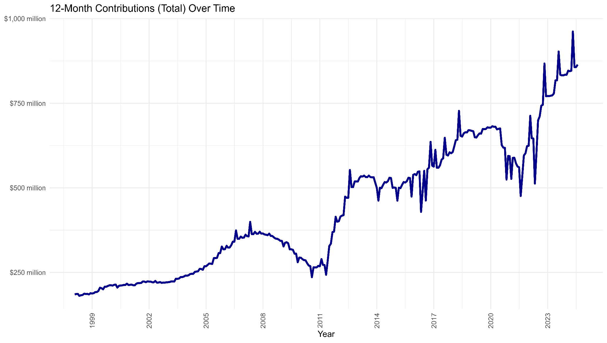
Trend in UI Contributions
Rates cut from 1.95% to 1.85% to 1.65% and held flat to present
Rates cut to 1.95% and held flat during UI bond repayment
Rates increased to 2.25% following Great Recession

Slide 19
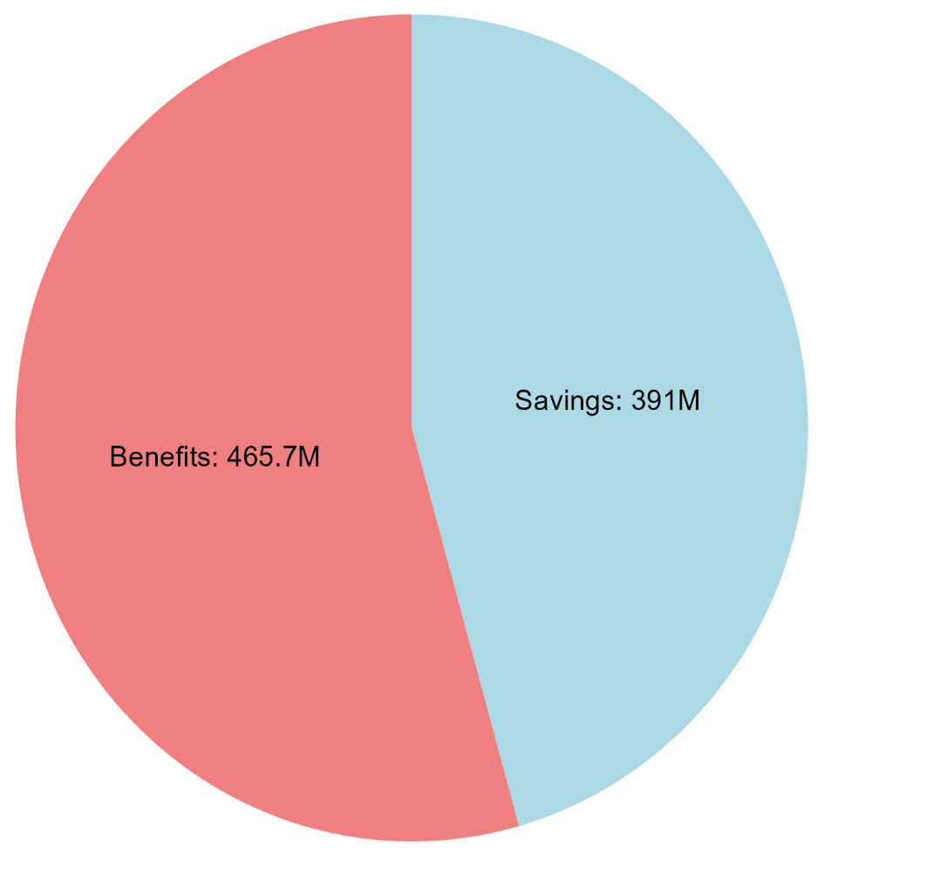
Key Statistics
Trust Fund Balance:
$1.41 billion to $1.75 billion
Average Annual Wage:
$60,906 to $62,786 (+3.0%)
Taxable Wage Base:
$40,600 to $41,800 (+2.9%)
Maximum Weekly Benefit:
$585 to $603 (+3.1%)
Where Contributions Go:

Slide 20
Inflation Impacts both Taxes and Benefits
Immediate impacts – responsive but capped:
As base period earnings rise, claimants qualify for higher weekly benefits and a higher maximum total benefit, up to the maximum weekly benefit amount. Reflects recent earnings, so benefits respond quickly.
As wages rise, the employee earnings subject to UI contributions rises, up to the maximum taxable wage base. Contributions for an employee earnings above the maximum wage base will be paid more quickly, but the annual total will not be higher.
Long-term impacts – impacts on an annual basis:
Maximum weekly benefit – effective in July – 50% of annual weekly wage.
Maximum wage base for tax – effective January 1 – 66.67% of average annual wage.

Slide 21
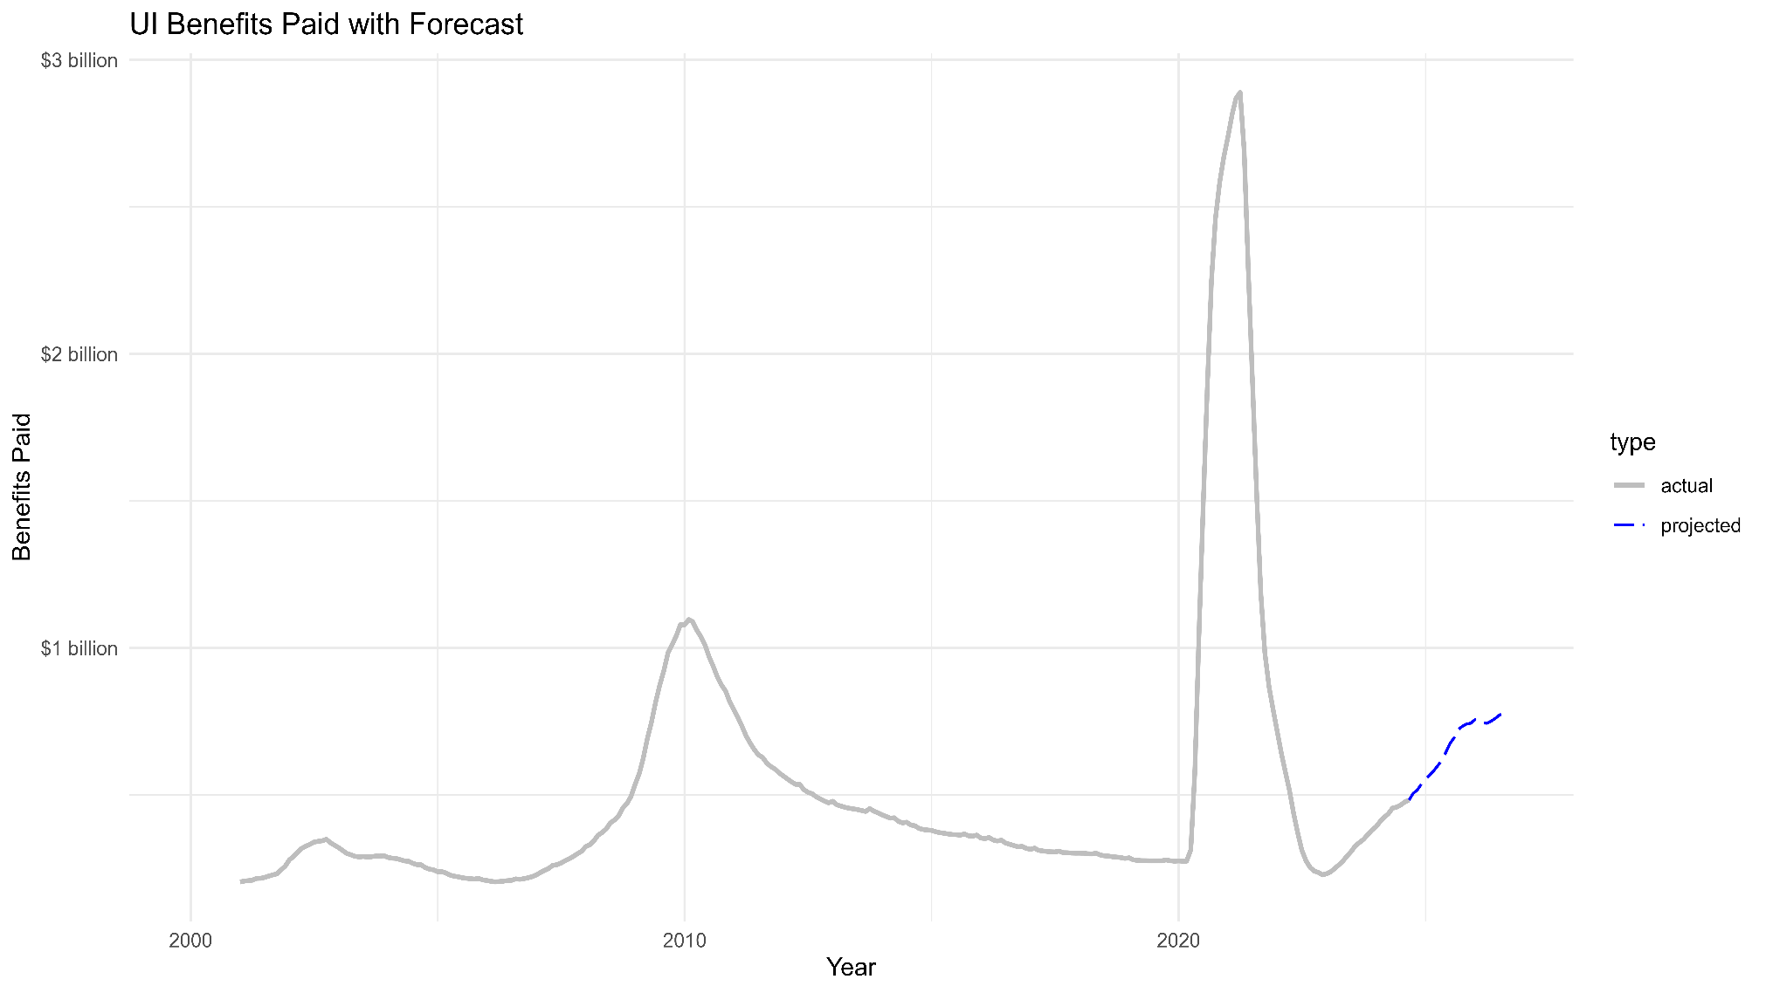
Projected Benefits

Slide 22
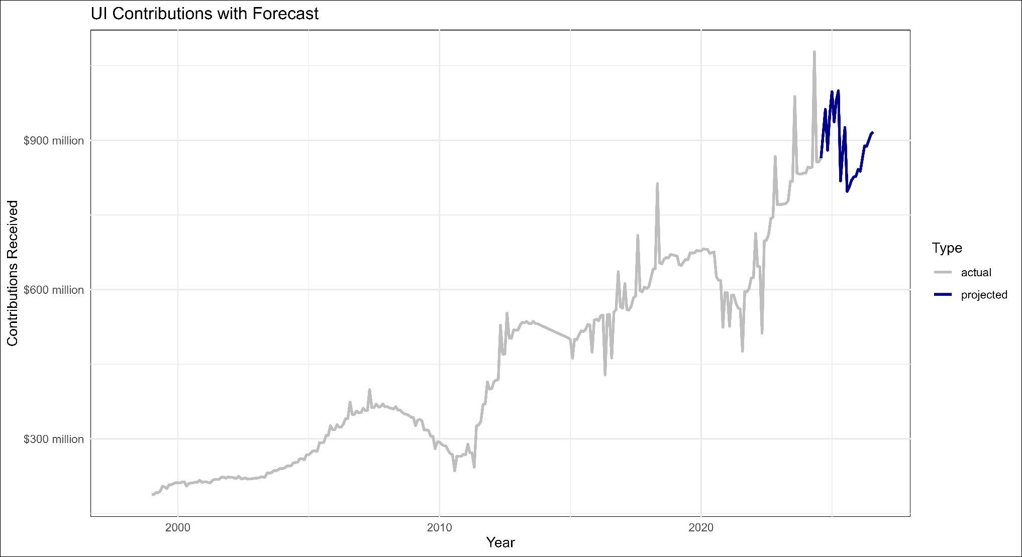
Projected Contributions (Current Rate)

Slide 23
Historic Cash Flows
Nevada Solvency Calculation |  | Actual | Actual | Actual | Actual | Actual | Actual | Preliminary
NRS 612.550 |  | 2018 | 2019 | 2020 | 2021 | 2022 | 2023 | 2024
Covered Employment |  | 1,204,250 | 1,242,021 | 1,147,075 | 1,168,229 | 1,297,501 | 1,344,079 | 1,364,263
Highest Risk Ratio |  | 18.85% | 14.48% | 38.63% | 43.55% | 43.55% | 43.55% | 43.55%
Highest Weeks Duration |  | 19.12 | 18.45 | 16.23 | 25.02 | 25.02 | 25.02 | 25.02
Average Weekly Payment |  | $347.18 | $360.52 | $364.15 | $377.93 | $403.50 | $438.55 | $488.52
Solvency Target (Millions) |  | $1,507.20 | $1,196.60 | $2,618.90 | $4,810.60 | $5,704.50 | $6,236.00 | $7,055.20
UI Trust Fund Level: October - September
Beginning Fund Balance (Millions) |  | 1,001.50 | 1,416.30 | 1,864.60 | 291 | -76 | 795.5 | 1,412.9
Contributions |  | 663.5 | 674 | 617.9 | 595.6 | 752.7 | 828 | 843.4
Benefit Payments |  | 281.8 | 268.7 | 2,232.20 | 862.3 | 228 | 349.2 | 492.6
Other Items |  | 33 | 43.1 | 40.7 | -100.3 | 346.7 | 146.6 | -18.2
Net Change in Fund |  | 414.7 | 448.3 | -1,573.60 | -367 | 871.4 | 617.4 | 332.6
Ending Fund Balance (Millions) |  | 1,416.30 | 1,864.60 | 291 | -76 | 795.5 | 1,412.90 | 1,745.5
Solvency Level (Millions) |  | -91 | 668 | -2,327.90 | -4,886.60 | -4,909.00 | -4,668.10 | -5,309.7
Multiple |  | 0.94 | 1.56 | 0.11 | -0.02 | 0.14 | 0.23 | 0.25
Average High Cost Multiple |  | 1.27 | 1.54 | 0.23 | -0.04 | 0.38 | 0.56 | 0.66
Average Tax Rate |  | 1.95% | 1.85% | 1.65% | 1.65% | 1.65% | 1.65% | 1.65%
CEP Assessment |  | 0.05% | 0.05% | 0.05% | 0.05% | 0.05% | 0.05% | 0.05%
Total Cost to Employers |  | 2.00% | 1.90% | 1.70% | 1.70% | 1.70% | 1.70% | 1.70%
Average Cost per Employee at Max Taxable Wage (excl FUTA & Interest) |  | $610.00 | $592.80 | $552.50 | $567.80 | $622.20 | $681.70 | $690.20
AHCM Target ($Millions) |  | $1,116.00 | $1,207.30 | $1,278.20 | $1,785.60 | $2,093.42 | $2,523.04 | $2,644.70
Taxable Wage Base |  | $30,500 | $31,200 | $32,500 | $33,400 | $36,600 | $40,100 | $40,600

Slide 24
Projected Cash Flows
Nevada Solvency Calculation |  | 1.55% Forecast | 1.65% Forecast | 1.75% Forecast
NRS 612.550 |  | 2025 | 2025 | 2025
Covered Employment |  | 1,382,668 | 1,382,668 | 1,382,668
Highest Risk Ratio |  | 43.55% | 43.55% | 43.55%
Highest Weeks Duration |  | 25.02 | 25.02 | 25.02
Average Weekly Payment |  | $562.70 | $562.70 | $562.70
Solvency Target (Millions) |  | $8,231.6 | $8,231.6 | $8,231.6
UI Trust Fund Level: October - September
Beginning Fund Balance (Millions) |  | 1,745.5 | 1,745.5 | 1,745.5
Contributions |  | 833.8 | 887.6 | 941.4
Benefit Payments |  | 590.8 | 590.8 | 590.8
Other Items |  | 40.2 | 41.1 | 42
Net Change |  | 283.2 | 337.9 | 392.6
Ending Fund Balance (Millions) |  | 2,028.7 | 2,083.4 | 2,138.1
Solvency Level (Millions) |  | -6,202.9 | -6,148.2 | -6,093.5
Multiple |  | 0.25 | 0.25 | 0.26
Average High Cost Multiple |  | 0.72 | 0.74 | 0.76
Average Tax Rate |  | 1.55% | 1.65% | 1.75%
CEP Assessment |  | 0.05% | 0.05% | 0.05%
Total Cost to Employers |  | 1.60% | 1.70% | 1.80%
Average Cost per Employee at Max Taxable Wage (excl FUTA & Interest) |  | $668.80 | $710.60 | $752.40
AHCM Target ($Millions) |  | $2,815.41 | $2,815.41 | $2,815.41
Taxable Wage Base |  | $41,800 | $41,800 | $41,800

Slide 25
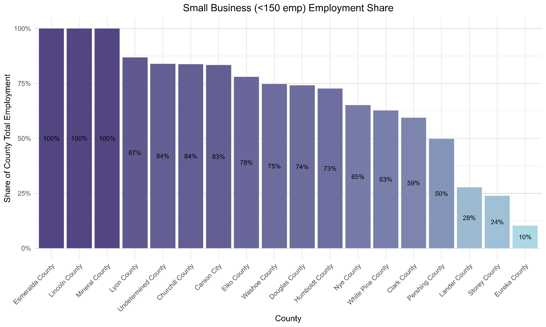
Small Business Employment Share by County

Slide 26
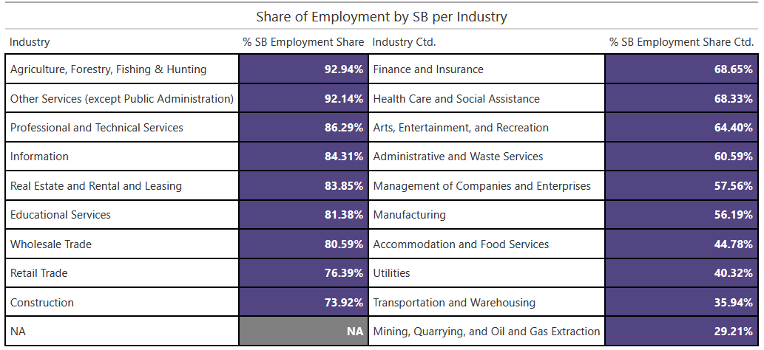
SB Employment Share by Industry

Slide 27
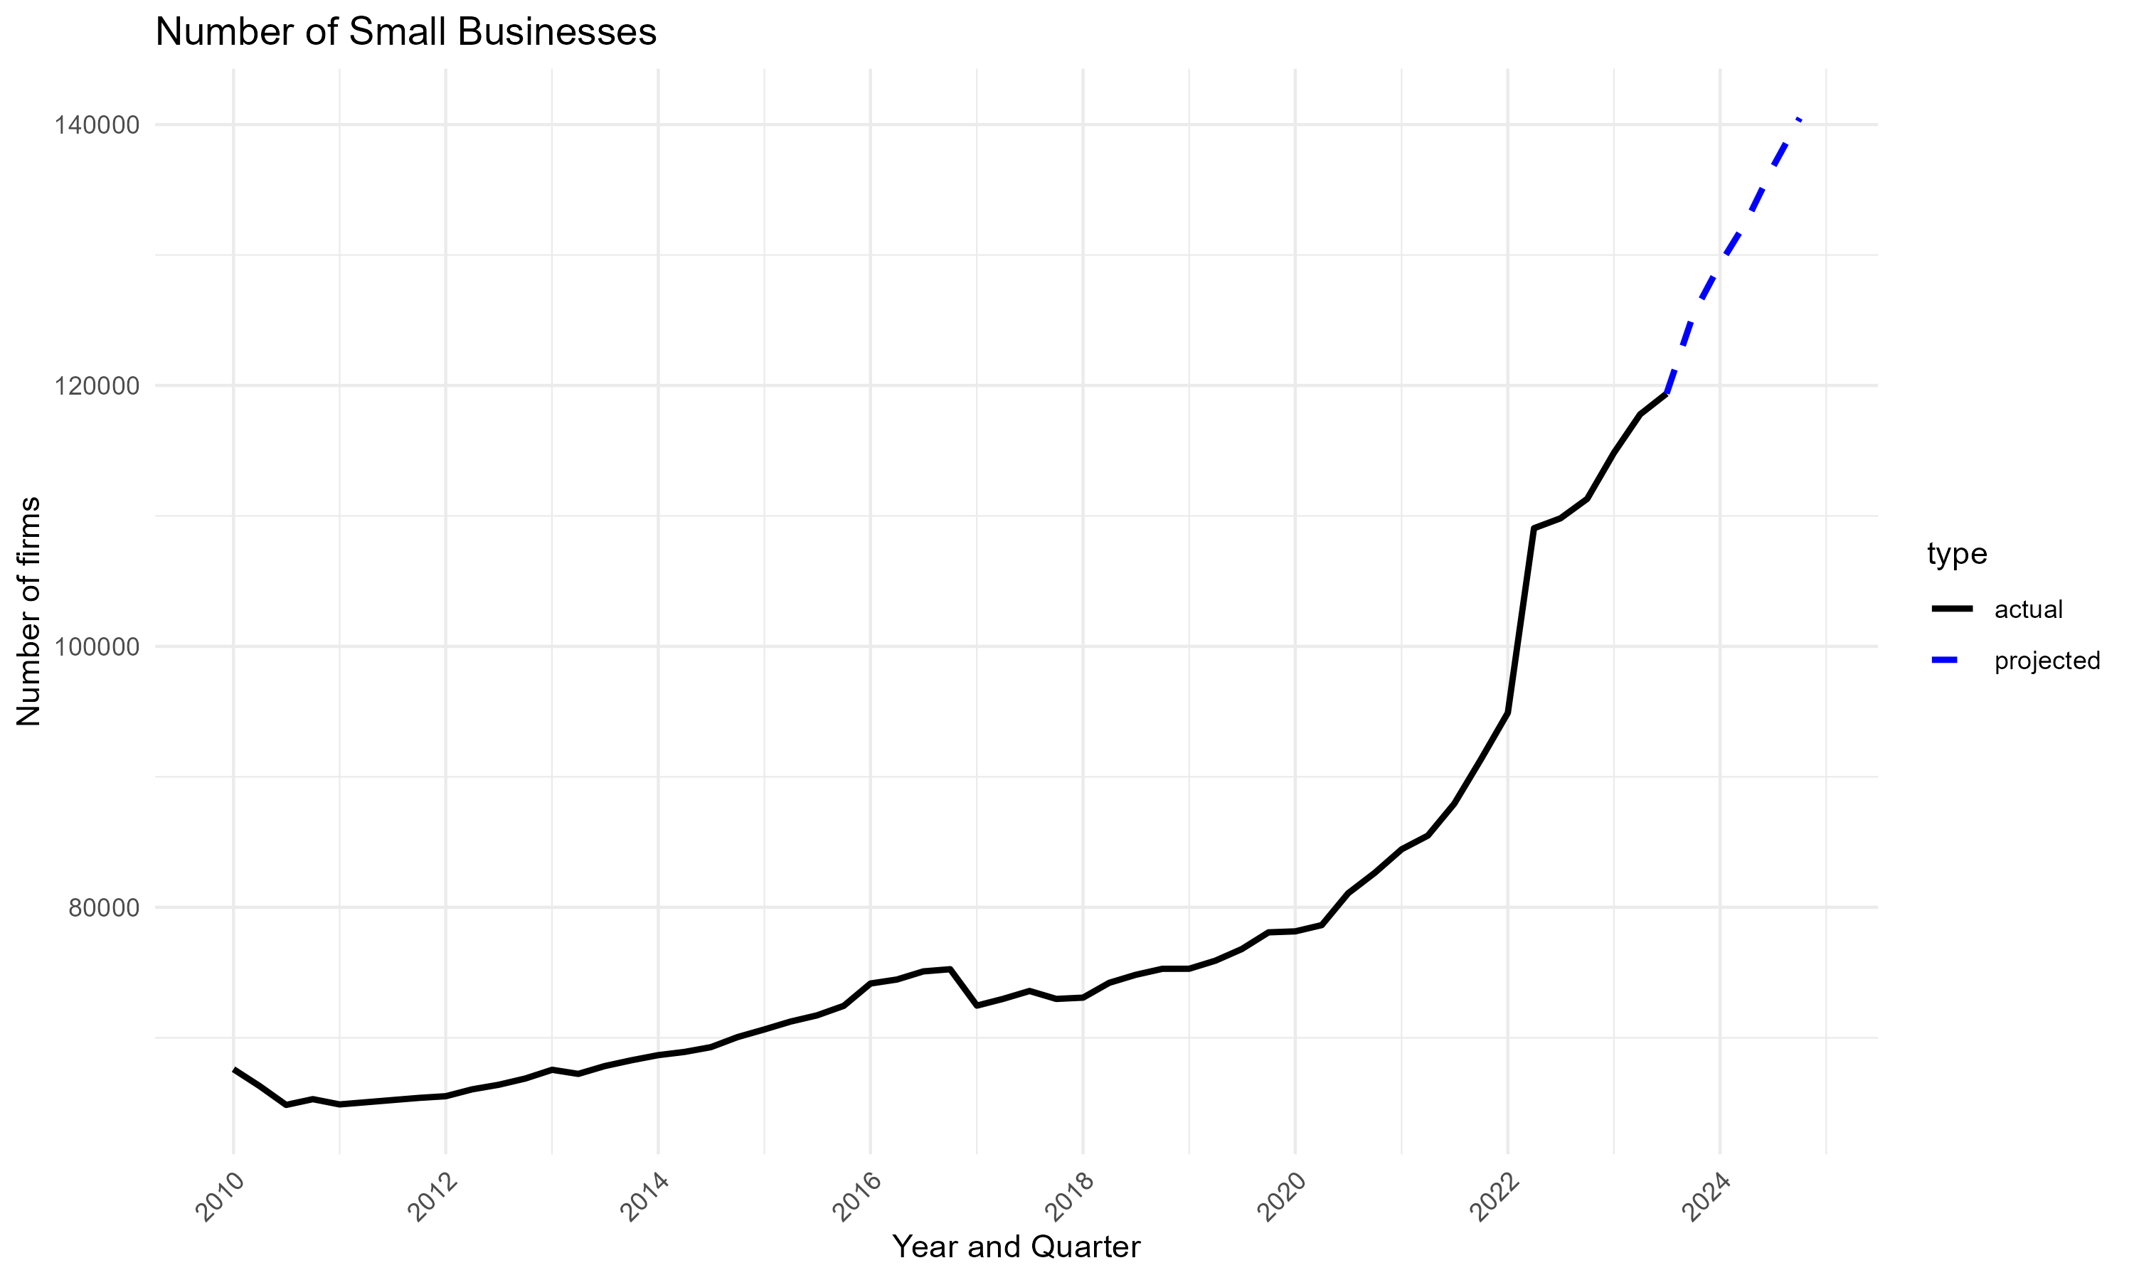
Number of Small Businesses

Slide 28
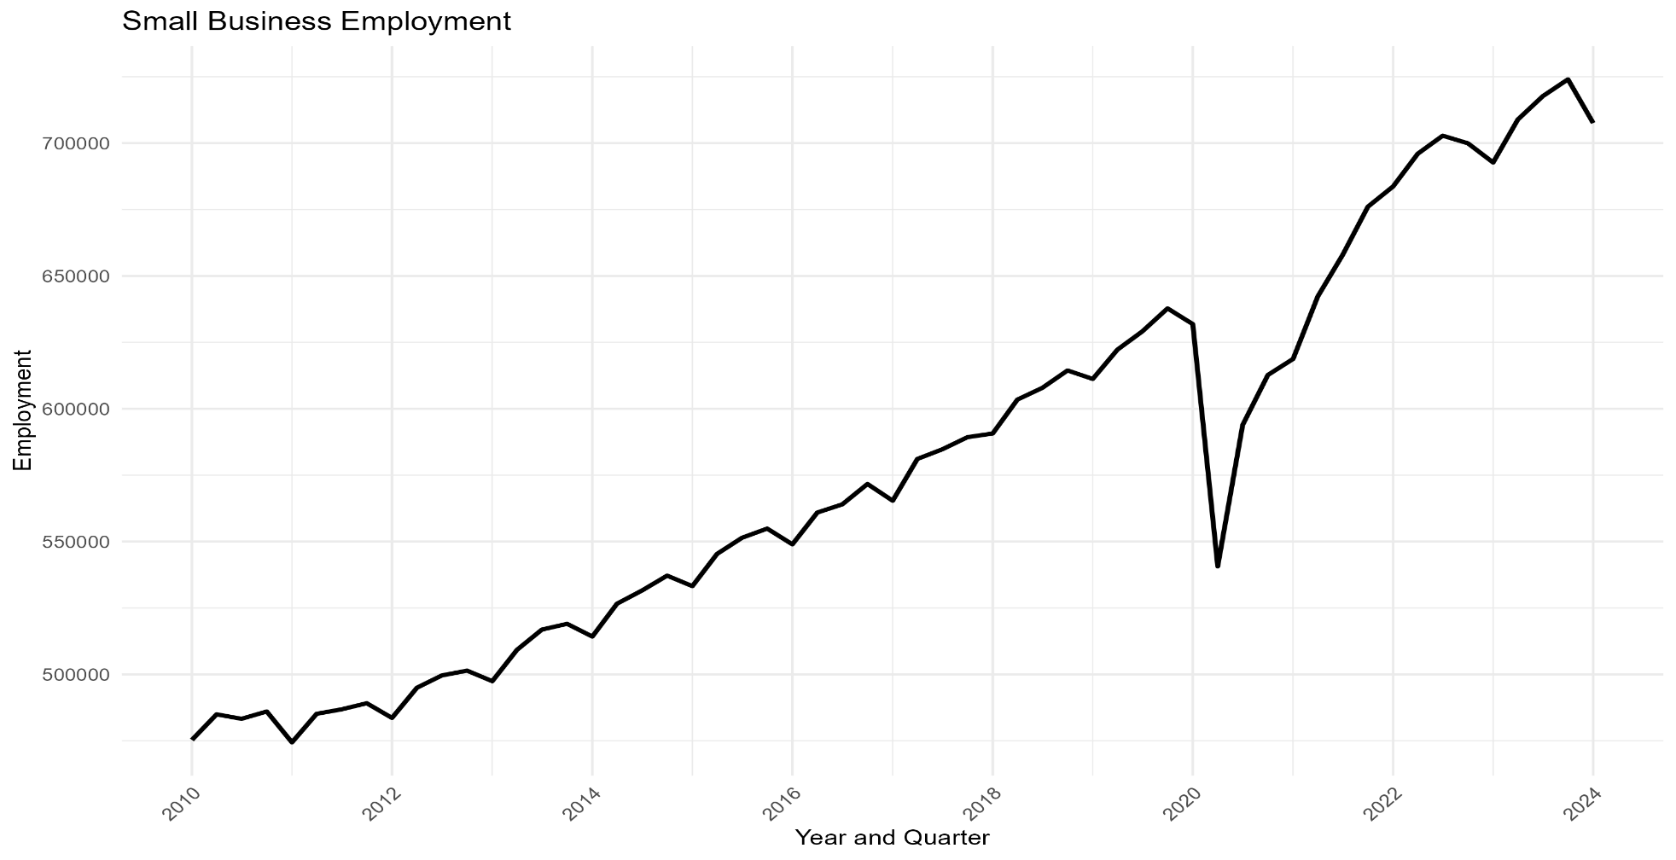
Small Business Employment

Slide 29
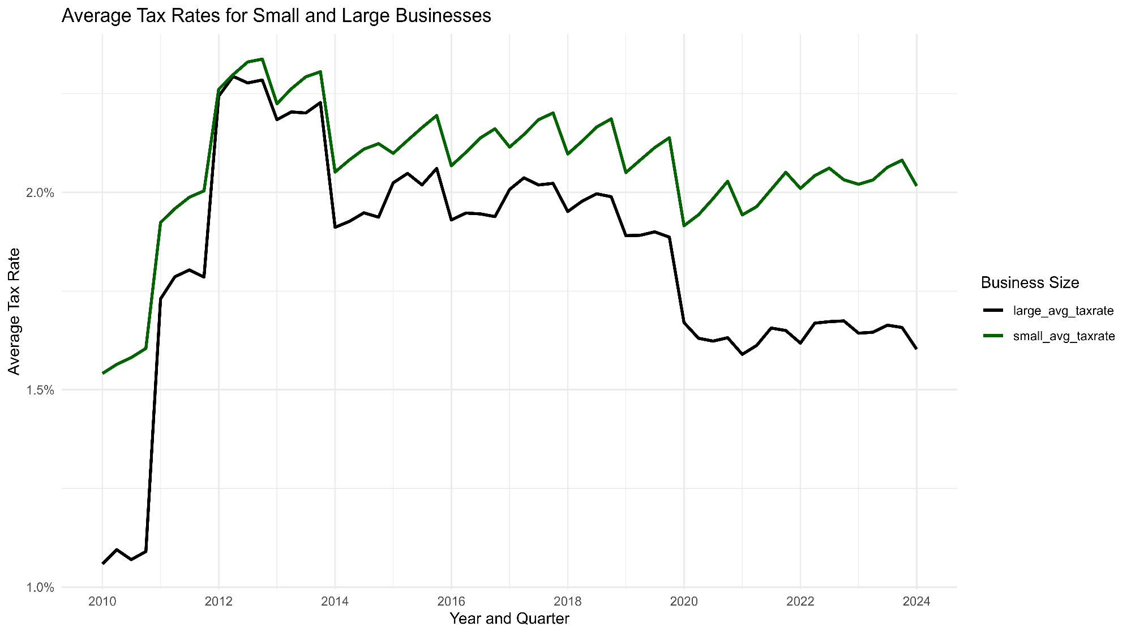
Effective Tax Rates, Small Business vs. Large Businesses

Slide 30
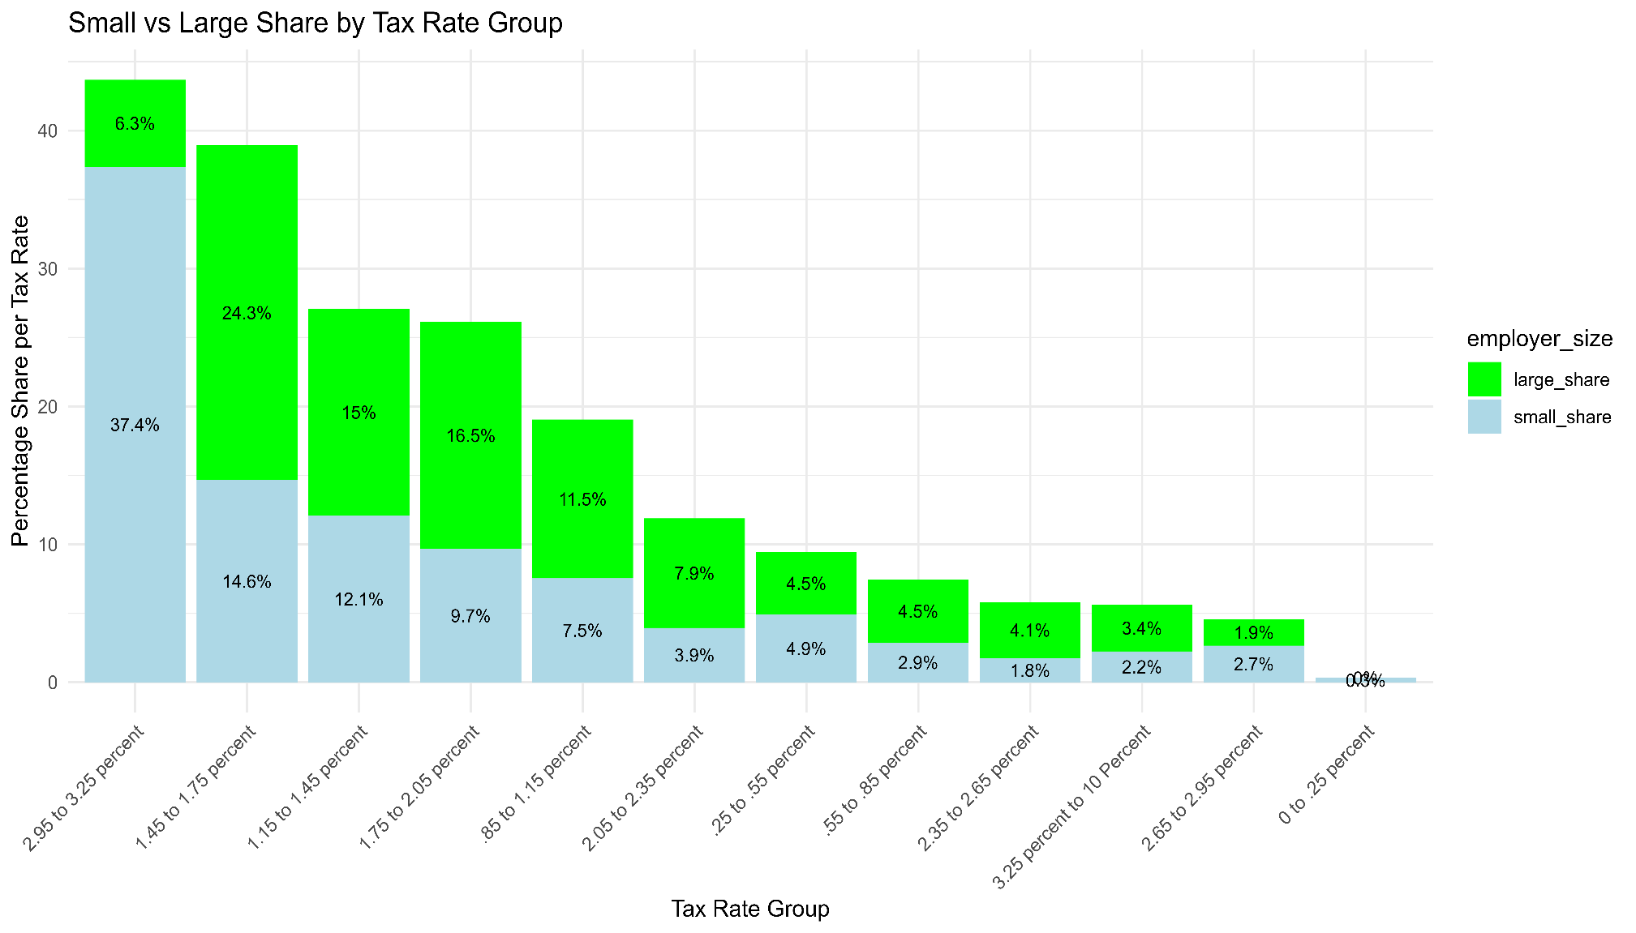
Distribution of Businesses by Effective Tax Rate

